Slide 1
Hampshire, Isle of Wight,
Portsmouth & Southampton
Strategic Violence Reduction Partnership
25/03/2024
13:00 – 15:00 hours
Chair: Police & Crime Commissioner,
Donna Jones

Slide 2
Agenda
Welcome & Introductions – Police & Crime Commissioner, Donna Jones
Actions from previous SVRP 02/11/2023 – Police & Crime Commissioner, Donna Jones
Home Office Update – Serious Violence Reduction Unit, Carl Binns
Serious Violence Duty, Financial Update & Delivery Plans – VRU Director, Jim Pegler
Crest Recommendations – VRU Programmes and Project Officer, Mandeep Hamer
Tactical Violence Reduction Partnership Update – Acting ACC, Clare Jenkins
Data & Analysis Update – Eastern VRU Manager, Sorrell Kenny
Hampshire & Isle of Wight Together Update – Inspector, Matt Gooding
Engagement & Communications Update – Western VRU Manager, Debbie Ashthorpe
Interventions, Evaluations & Opportunities Update – Northern VRU Manager, Elle Snookes
Workforce Development – Northern VRU Manager, Elle Snookes
Any Other Business – All Partners.

Slide 3
Actions from previous SVRP 02/11/2023
1) VRU (Mandeep Hamer) – To work with partners to develop a detailed statement that describes how they, as a Specified Authority under the PCSC Act, are meeting the Serious Violence Duty. VRP SVD Agreements document drafted for review by the SVRP Board, prior to sign off.
2) VRU (Jim Pegler) – To develop funding model options for the SVRP, that would maintain levels of strategic coordination for delivering the VRP Response Strategy. Following consultation with the PCC, and in view of funding announcements, this has been delayed. After the elections, the PCC will consider functionality of the VRU that can be ‘mainstreamed’ into the OPCC. Once established, VRU ‘at risk’ activity (in terms of sustainability) can be identified and raised at SVRP.

Slide 4
Home Office Update

Slide 5
VRP Response Strategy

Slide 6
Serious Violence Duty (SVD)
The VRU supports the duty holders in the VRP

Slide 7
Serious Violence Duty
The VRP has 23 partners (specified authorities) with different geographic responsibility, resources and challenges
Local Delivery through CSPs will be where individual outcomes can be achieved
CSPs need a place to work tactically together on individuals impacted by serious violence and geographic hotspots
Education are a key enabler for local partnership work
At a Police Force Level, Local Authorities are partners to each other
The VRP should build additional capability not replicate what exists
The challenge is to remain focused on longer term strategic objectives that can be delivered through the VRP, despite the financial challenges.

Slide 8
SVD Grant 2023 – 2024
Staff, Training and Recruitment – £173,091
Data Sharing & Analysis – £66,930
Commissioned Interventions – £39,712
The Legacy Project (Yellow Brick Road Projects) – Test Valley (Romsey)
Next Steps (No Limits) – Basingstoke & Deane, Southampton, Portsmouth and Isle of Wight
Other costs – £2,768
Total expenditure for SVD Grant: £282,501

Slide 9
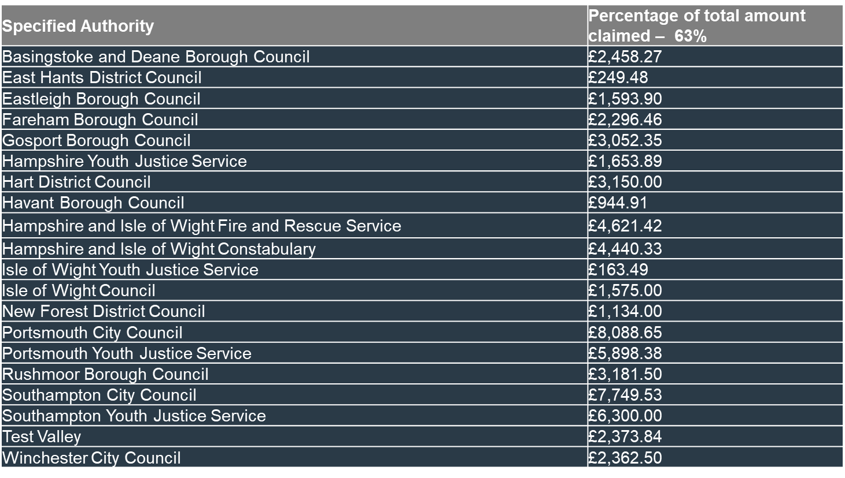
SVD Grant 2023 – 2024
Total payments to Specified Authorities from SVD Grant: £63,287.90

Slide 10
Violence Reduction Unit Grant 2023 – 2024
Staff, Training and Recruitment – £465,525
Data Sharing – £51,328
Commissioned Interventions (VRU Core Budget) – £456,190
Choices Year 6&7 Schools Project (Artswork)
A&E Navigators (No Limits)
RESET Custody Navigators Intervention (SSJ)
Trauma Informed Practitioners (Rockpool)
Pitch Up and Play Football (AFC Bournemouth)
Mavericks (Music Fusion)
Choices (Motiv8) – Gosport, Havant, Fareham, The Portsmouth Academy
Safer Pathways (Youth Options) – Southampton, New Forest, Eastleigh
New Beginnings (Southampton City Council)
Local Evaluation – £78,544
Other costs – £6,726
Total expenditure for VRU Grant: £1,058,313

Slide 11
SVD & VRU Delivery Plans 2024 – 2025
SVD Labour Costs:
Staff:
Police Inspector to lead on VRP engagement for HIOWT – £89,000
New VRU Evaluation and Data Officer – £40,000
CSP Analysis to support SNA – £38,700
VRU Comms and Engagement Officer – £54,000
OPCC Commissioning Manager Support – £8,000
Total: £231,125 (including £1,425 travel)
SVD Non-labour Costs:
Interventions:
The Legacy Project (Yellow Brick Road Projects) – £4,000
Next Steps (No Limits) – Basingstoke & Deane, Southampton, Portsmouth and Isle of Wight – £16,142
Annual forecast for SVD Grant: £251,267
VRU:
Staff, Training and Recruitment – £430,628
Data Sharing – £100,000
Commissioned Interventions (from VRU Core Budget) – £423,000
Choices Years 6&7 Schools Project (Artswork) – £55,000
A&E Navigators (No Limits) - £140,000
RESET Custody Navigators Intervention (SSJ) – £150,000
Trauma Informed Practitioners (Rockpool) – £58,000
Choices: Fareham, Gosport, Havant, The Portsmouth Academy (Motiv8) – £20,000
Local Evaluation – £93,542
Annual forecast for VRU Grant: £1,047,170

Slide 12
Crest Recommendations
In May 2023, 18 recommendations were published in the ‘Joint Readiness Assessment for Hampshire & Isle of Wight’
As of March 2024:
44.4% (n. 8) of these recommendations have been evidenced
55.6% (n. 10) of these recommendations are still in progress
The recommendations still in progress are being delivered through the relevant VRP Sub-group for partnership ownership and collaboration
These recommendations have been agreed on the VRP Sub-groups’ Terms of Reference (ToR), in alignment with the:
Theory of Change (ToC) Activity
Outcomes Based Performance Framework (OBPF)
For further details of the specific recommendations and evidence of achievement please visit Useful Documents - Hampshire Police and Crime Commissioner (hampshire-pcc.gov.uk)

Slide 13
TVRP Cover Page

Slide 14
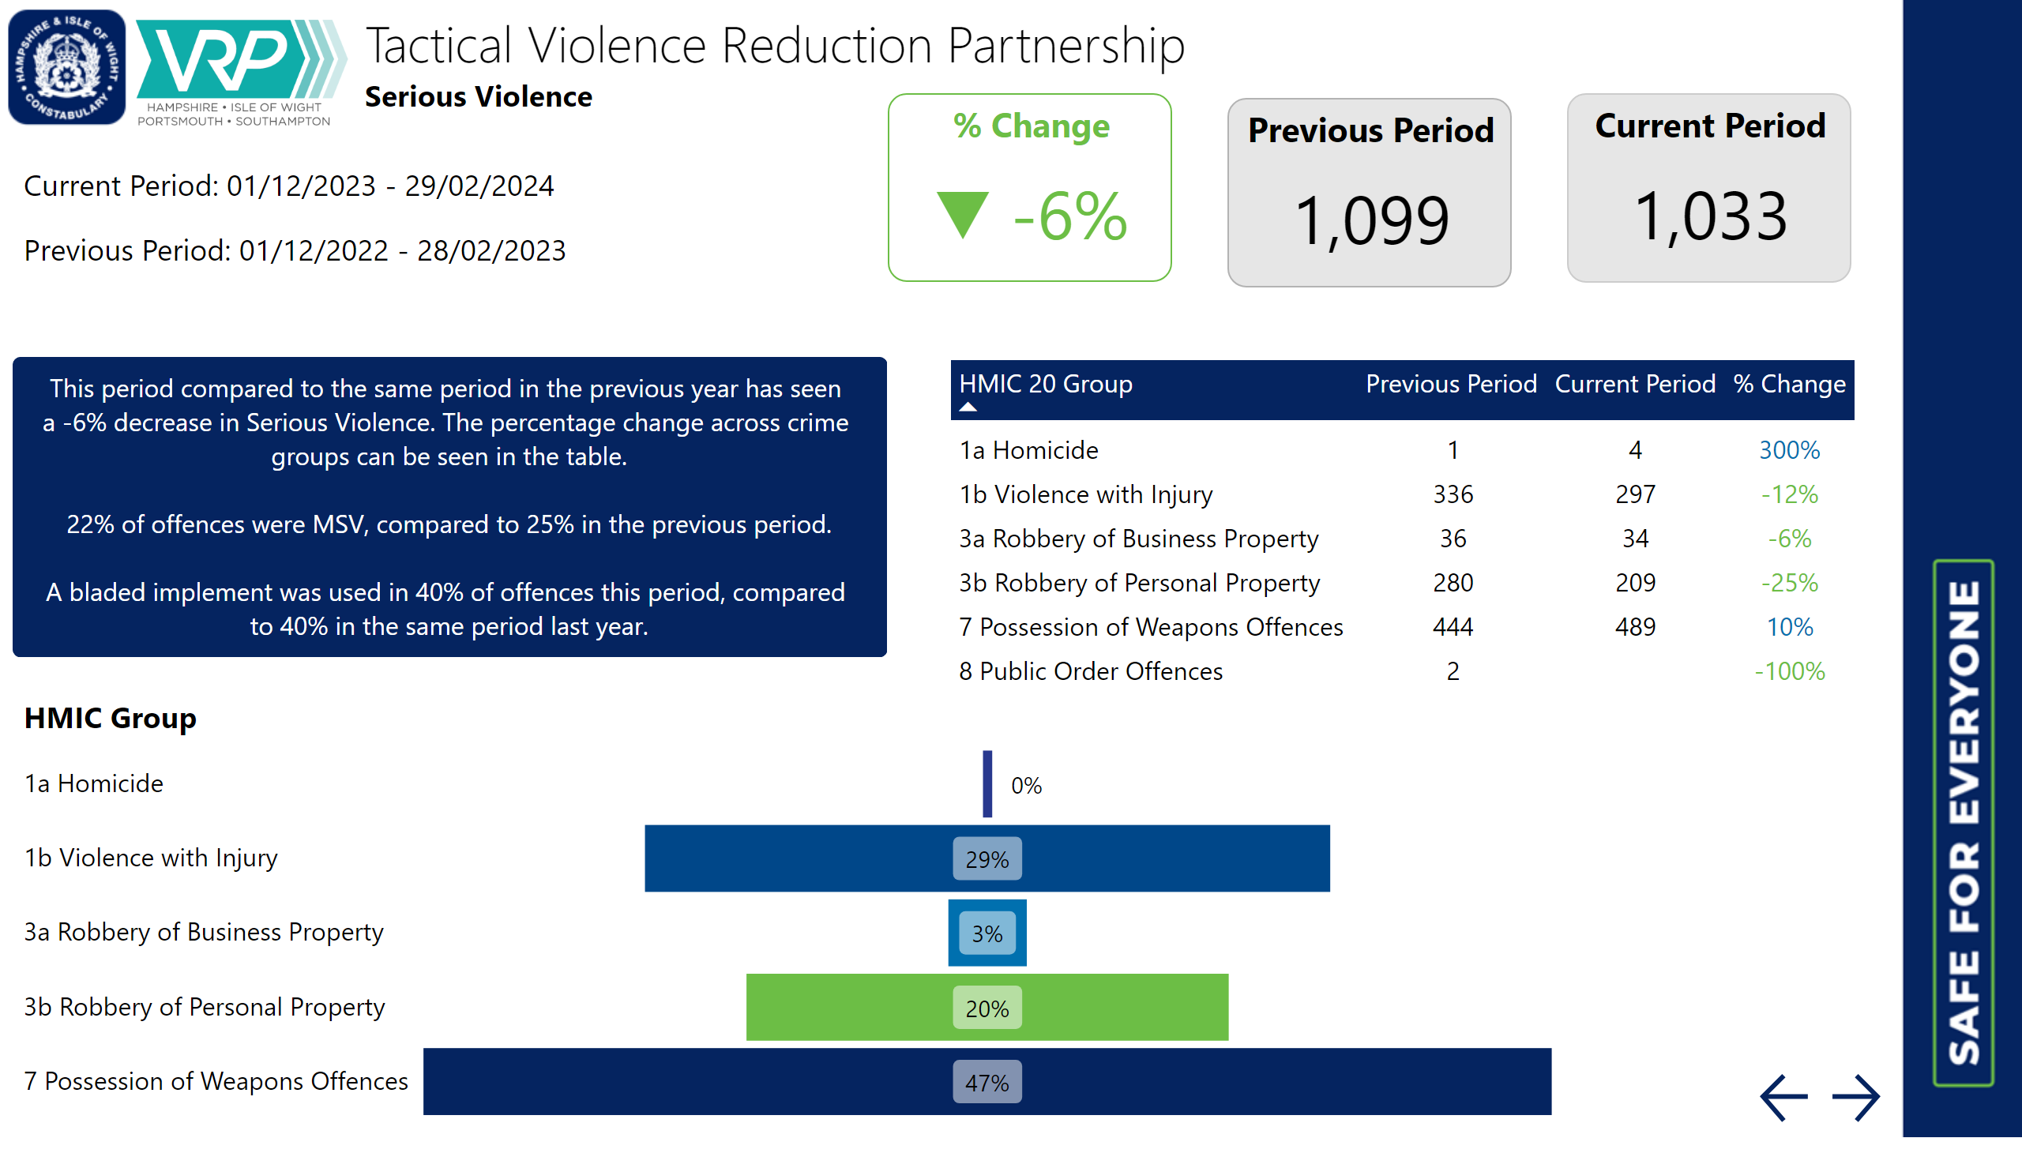
TVRP Slide 1

Slide 15
TVRP Slide 2
General trends across the months have been consistent with the previous year with the greatest increases seen in March (+21.4%) and June (+12.0%). February has seen the greatest decrease compared to the previous year (-14.9%).
The same period last year (SPLY) saw a more obvious summer peak, whereas 2023, volumes remained relatively stable from May through to October.
The overall volumes across the 12-month period have seen a -1.9% decrease.

Slide 16
TVRP Slide 3
There has been an increase in serious violence in n. 6 of the districts. Fareham saw the greatest increase.
Seven (n. 7) districts have seen a decrease in serious violence with the largest seen in Gosport.
Eastleigh saw no change in offences across the three month period but saw statistically significant decreases in December.

Slide 17
TVRP Slide 5
For the latest 12-month period (01/03/2023 – 29/02/2024), there were n. 20 top serious violence perpetrators accounting for n. 101 crimes.
The offences were in n. 7 different districts (SOUTHAMPTON, PORTSMOUTH, FAREHAM, EASTLEIGH, TEST VALLEY, NEW FOREST and HAVANT).
A bladed implement was used in n. 39 offences.
8% (n. 8) of these offences were MSV (GBH and above).
65% (n. 13) of these nominals were identified as Habitual Knife Carriers (HKCs) in the latest refresh (January 2024).
80% (n. 16) of the nominals are aged under-18.

Slide 18
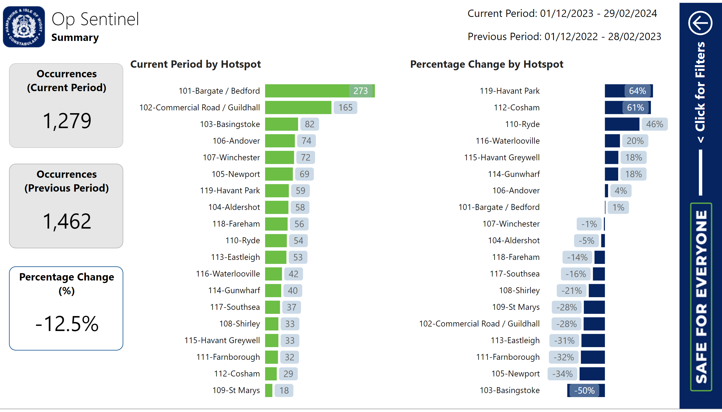
Quarters

Slide 19
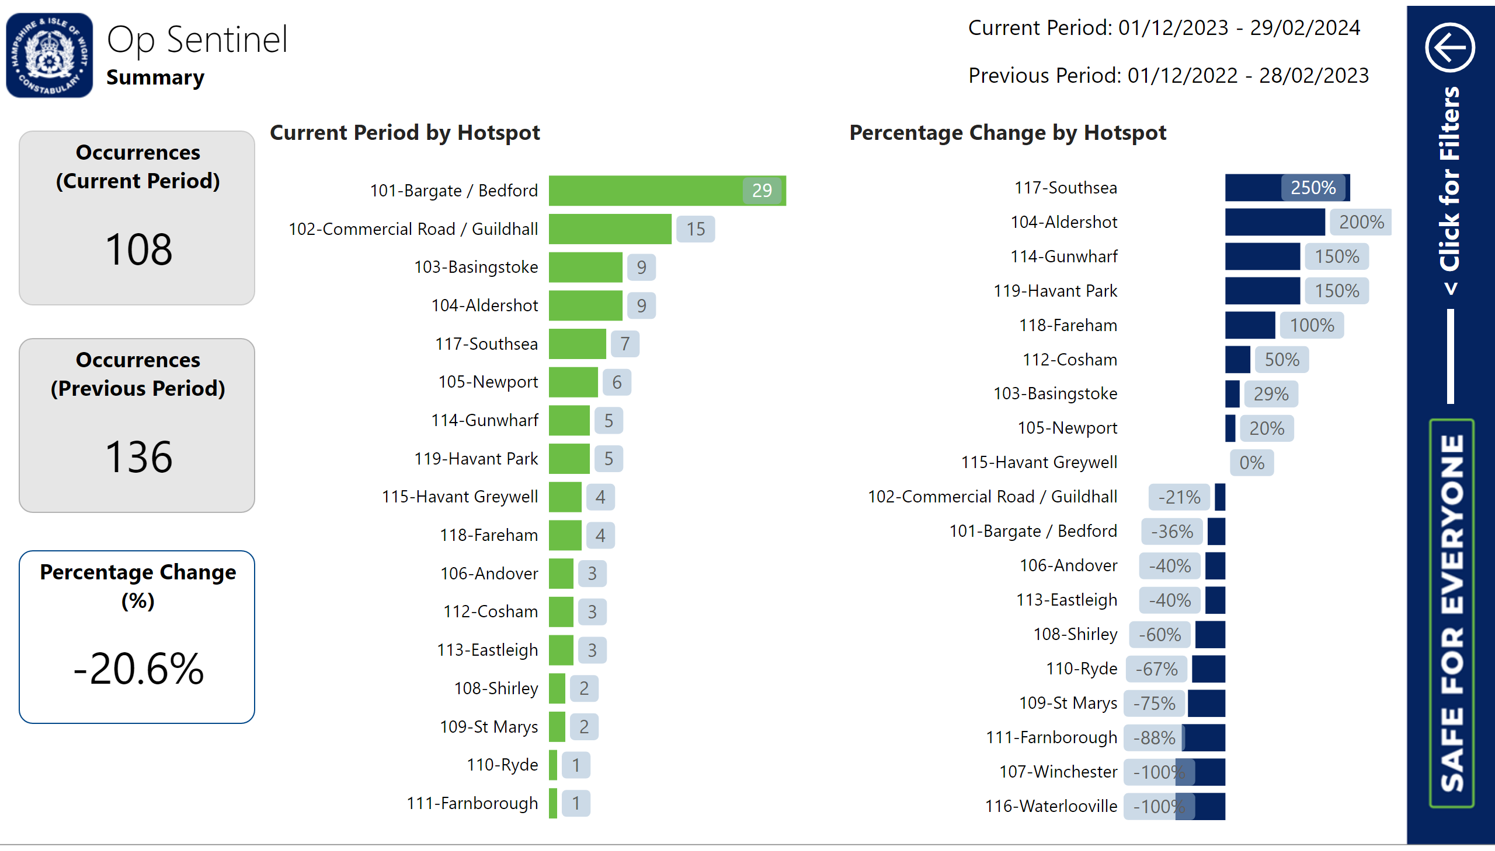
Quarters

Slide 20
Violent Crime Taskforce Update
Now aligned to areas in line with new model of Policing in Hampshire and the Isle of Wight
Providing tactical advice and support in relation to Serious Violence Hotspots and the management of Serious Violence Perpetrators and Habitual Knife Carriers
Attending internal Tactical Planning Meetings (TPMs) and Partnership meetings such as PAGs
Working closely with partners and the Violence Reduction Unit to problem-solve in hotspots
Current work includes: Working in St Marys, Southampton on a long-term robbery problem; in Havant to address long-term serious violence and ASB issues in the Greywell; and in Portsmouth on an escalation of serious violence.
Future Plans
Op Sceptre 13th – 19th May. Working with the VRU to expand the opportunities for engagement with communities and partners to prevent knife crime
3 Permanent Surrender bins to be placed in Southampton
Working with Border Force to increase positive outcomes for the importation of knives and weapons.

Slide 21
GRIP Funding Update
Hampshire and the Isle of Wight Constabulary will receive over £1.4 million for serious violence and ASB hotspot policing for 2024-5
Current serious violence hotspots (Op Sentinel) will remain the same
ASB data for the past 2 years from 01/01/22 – 21/12/23 has been analysed and a further 6 hotspots have been identified: 2 in Gosport, 3 in Portsmouth and 1 in Southampton
Proposal has been sent to the Home Office for continued funding of serious violence hotspots with the additional request for 2 x Analysts for ASB, a Crime Prevention Advisor (CPA) and 3 x ASB Tactical Advisors
The proposal includes £300K for partners for hotspot patrolling and forms have been sent out to CSP Managers for their bids and plans in line with the criteria, which includes: the need to be visible, to provide returns for the patrols and commit to an agreed patrol pattern. This amount is flexible and the proposal can be re purposed if bids exceed £300K.

Slide 22
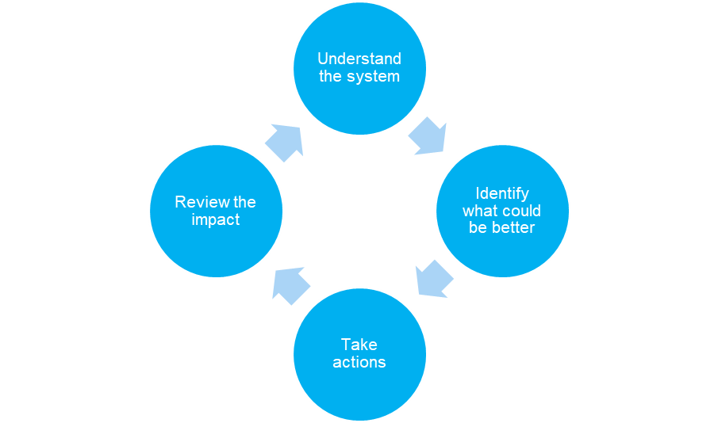
Multi-agency and Systems Change
Partnership System Change:
It’s everyone’s responsibility to understand the system and be part of the change
There is good practice within the system but partners recognise the need for improvement
One size does not fit all but some organisations may benefit from a consistent approach.

Slide 23
Multi-agency and Systems Change
Progress Ambition
Cohorts identified using police data and shared
Serious violence hotspots identified and data shared on these hotspots
Performance data is regularly shared
Violent Crime Taskforce Officers & Crime Prevention Advisors in place to lead problem solving in partnership
VRU Mangers supporting practitioners
Violence Reduction Fund Grants responded to identified need at CSP level
Cohorts identified using partnership data –
not just high risk cohorts
Partnership data available in reports to practitioners
Partnership response to hotspots and individuals impacted by violence is business as usual
Forums are de-conflicted, not reliant on specific individuals and outcomes focused.

Slide 24
Multi-agency and Systems Change
STARR Model

Slide 25
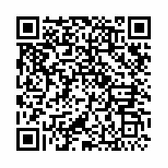
SVRP Survey
The Outcomes Based Performance Framework is used for measuring progress towards partnership aims
Strategic objective: Multi-agency and Systems Change
Success measure: Specified and Relevant authorities have a good understanding of their role in key aspects of the response to serious violence
The survey will capture your understanding of your role in the partnership response and highlight areas that require further clarity and focus:
https://survey.alchemer.eu/s3/90635289/VRP-Specified-and-Relevant-Authorities-Understanding-of-SV-Response-Role

Slide 26
Data & Analysis Update
Following successful co-production of the Strategic Needs Assessment (SNA) in 2023 a meeting was held between partners to discuss what worked well, learning and aspirations for 2024
£38.7K has been allocated from the SVD Grant to support co-production of the 2024 SNA between the VRU, CSP and Public Health Analysts
The VRU Analyst role is currently vacant. HIOW Constabulary have agreed to recruit and second another Analyst to the VRU but current timeframes are unknown.

Slide 27
Data & Analysis Update
The Partnership Data Tracker has been updated and contains all the data sources and locations included in the HIPS wide SNA
More than 40 partnership data sources were utilised in the HIPS-wide SNA and from across all the specified and relevant authorities in the HIPS area
There are increased numbers of specified and relevant authorities sharing data ​directly which is monitored through the Outcomes Based Performance Framework:
Q1:16%, Q2: 16%, Q3: 35%, ​Q4: 59%
The updated Partnership Data Tracker has been uploaded to the VRP ‘Useful Documents’ page on the website Useful Documents - Hampshire Police and Crime Commissioner (hampshire-pcc.gov.uk)

Slide 28
Sharing data saves lives and reduces demand

Slide 29
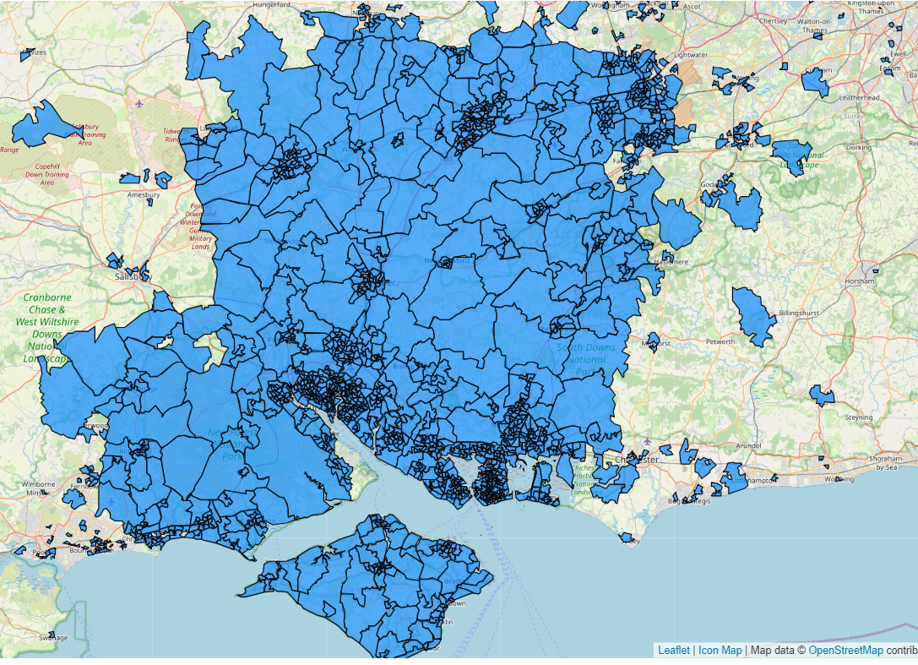
HIOWT Update
Better Together Programme Team
Thames Valley Together
Hampshire & Isle of Wight Together

Slide 30
Proposed Strategy 2024 – 2025
Enable the VRP to meet our data sharing obligations under the SVD
Deliver a core suite of products cross-partnership
Build a community of users across the partnership
Demonstrate how HIOWT can support effective research into risk and protective factors
Develop a sustainability plan for 2025 – 2026.

Slide 31
Steps to join HIOWT
Discovery phase
Governance and sign up
Personnel & Vetting
Security & Access Configuration
Data Platform Configuration
User onboarding & training
Transition to BAU
Organisation SPOC
Senior Lead
Technical POC
IG / Data Protection
Reporting team / analyst
Partnership Tasking Group
HIOWT Programme Board

Slide 32
Engagement Update
Short
Map existing partnership engagement with communities and young people
Understand gaps and barriers, to ensure more meaningful, inclusive engagement
Localised engagement with communities and young people
Medium
Develop methods of engagement to survey HIPS communities
Ensure community voice captures cohorts most impacted by violence
Use this data to develop an evidence base
Consider key VCSE organisations to work with local communities
Long
Consistent method to survey HIPS communities
Results inform SNA, activity and commissioned services
Embed views into the Response Strategy & governance arrangements, and communities should support design of interventions
Partners develop community hubs & spaces and share community assets

Slide 33
Engagement Model

Slide 34
Communications Update
Short
Create VRP brand
Comms & Engagement working groups to develop Comms Strategy
Medium
Create VRP website and launch this to communicate with partners and the public
Highlight work of key partners in the VRP meeting the Serious Violence Duty
Long
Celebrate the work of communities and VRP working together
Develop a strength-based counter-narrative, including opportunities for co-production with communities
Develop a sustainable model for VRP Communications & Engagement

Slide 35
Op Sceptre Knife Crime Awareness Week
13th – 19th May 2024

Slide 36
Interventions, Evaluations & Opportunities Update
VRU & SVD HIPS-wide grant funded interventions Choices – Year 6 & 7 Schools Project RESET – Custody Navigators Intervention A & E and ED111 Navigators TIPS – Trauma informed practitioners with Police

Slide 37
Interventions Update
Choices – 70 schools booked in going into 2025, a reach of 7000 children. Incredibly positive feedback from teachers and children. Choices was on ITV which increased interest in the programme, some schools asking to come back next year.
Challenge – Schools in crisis due to sick leave (Covid & stress) meaning not all planned staff commitment can go ahead, schools are not able to commit to the evaluation ask
Hotspot and target area bookings this academic year, since the freeze on generic referrals, have increased by the following:
 | Schools | Pupils | Teachers
Hotspot | 10 | 1575 | 45
Target Area | 11 | 1562 | 70
A further 3 schools (310 pupils & 12 teachers) from target areas have committed to participate.

Slide 38
Interventions Update
RESET (Custody Navigators) – 87 individuals supported across HIPS to date with an increase in Q4 expected.
For the purposes of analysing the cohort of individuals offered support they are split into three groups, those who refused to engage on offer, those who agreed and met navigator but took it no further and finally, those who accepted support and continued outside of custody with Navigator support.
Among the ten most common offence types, four offences fit into the serious violence definition, indicating there are large number of individuals referred to RESET who have engaged in serious violence offences. This is consistent with the most common offence types among the RESET age demographic. These results indicate that there are specific crime types of which individuals are more likely to engage with RESET. ​
Early indications suggest there may be a general upper limit to the level of harm the average individual who accepts a RESET referral will have inflicted in the past twelve months in order for that ‘reachable, teachable’ moment to have the most impact.
The journey continues in collaboration with provider and the evidence base to ensure the service is targeted appropriately at individuals at higher risk of being impacted by serious violence.

Slide 39
Interventions Update
A&E Navigators (ED111) – 1579 young people reached this year, with 83% of YP having improved scores on the Mental Health Pain Scale after interaction with youth worker. No Limits have begun to trial volunteers in A&E and have increased social media targeted at young people
Challenge– lack of safe space for holding discussions with young people. Being addressed through partnership working.
TIPS 330 young people under 25, 521 over 25 and 252 professionals trained – positive feedback from police staff and public on impact of TI learning. Home Office visited and were very impressed.
Challenge – there are quiet times where TIPs can’t support more busy teams, they are looking at reviewing and feeding back on PPNs in this time.

Slide 40
Evaluations Update
Commissioning and Evaluation Approach – provides consistency across partnership
VRP Theory of Change – Outlines the journey towards partnership outcomes
Outcomes Based Performance Framework – Monitors progress towards the VRP outcomes
Commissioned evaluations (Liverpool John Moores University) – Process and impact evaluations of commissioned interventions.

Slide 41
Workforce Development
The Serious Violence Toolkit was launched on the 19/03/2024 and reached almost 600 partners.

Slide 42
Thank you!
Violence Reduction Unit - Hampshire Police and Crime Commissioner (hampshire-pcc.gov.uk)

