Slide 1
Hampshire, Isle of Wight,
Portsmouth & Southampton
Strategic Violence Reduction Partnership (SVRP)
04/06/2024
09:30 – 11:00 hours
Chair: Police & Crime Commissioner,
Donna Jones

Slide 2
Agenda
Welcome & Introductions – Police & Crime Commissioner, Donna Jones (5mins)
Actions from previous SVRP 25/03/2024 – Police & Crime Commissioner, Donna Jones (5mins)
VRU Director Update – VRU Director, Jim Pegler (20mins)
VRP Strategic Objectives & Project Plan – VRU Project Officer, Mandeep Hamer (5mins)
Tactical Violence Reduction Partnership Update – Inspector, Sarah Nicholson (10mins)
Data & Analysis Update – Eastern VRU Manager, Sorrell Kenny (5mins)
Hampshire & Isle of Wight Together Update – Inspector, Matt Gooding (5mins)
Engagement & Communications Update – Western VRU Manager, Debbie Ashthorpe (10mins)
Interventions, Evaluations & Opportunities Update – Northern VRU Manager, Elle Snookes (5mins)
Workforce Development – Western VRU Manager, Debbie Ashthorpe (10mins)
Any Other Business – All Partners (10mins).

Slide 3
Actions from previous SVRP 25/03/2024
The PCC to send letter to all Specified authorities to stress the importance of attendance at the SVRP, or nominate a representative in their absence. Due to the elections a different approach was taken and Specified authorities were contacted individually.
All Specified and Relevant authorities to familiarise themselves with the Terms of Reference for the SVRP, with a specific focus on the agreement to meet the Serious Violence Duty. Feedback to be provided on any amendments to these agreements and VRU Managers to engage and assist with partners accordingly where required.
All partners to complete the SVRP Survey to establish their understanding and response to tackling Serious Violence. If your organisation has not yet completed the survey then please complete via this link https://survey.alchemer.eu/s3/90635289/VRP-Specified-and-Relevant-Authorities-Understanding-of-SV-Response-Role

Slide 4
VRU Director Update – SVRP
The SVRP is the ‘Core Group’ for the purposes of the VRU Grant
The SVRP also oversees and agrees delivery of the SVD Grant
The Terms of Reference set out how the meeting and Sub-groups allow the Specified and Relevant Authorities under the PCSC Act discharge their Serious Violence Duty
The VRP Response Strategy sets out the actions the VRP will take together.
The Duty requires ‘collaboration and co-production’ as a partnership working with and for the community.

Slide 5
VRP Cycle of Activity at HIPS to meet the Serious Violence Duty
Specified Authorities should understand roles at CSP and HIPS geography
CSP Plans must also reference Serious Violence and set out the local response

Slide 6
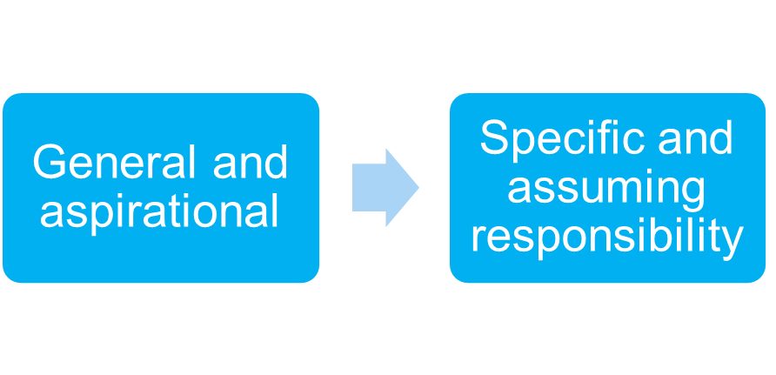
Statements for Specified Authorities
Who is responsible for understanding and the compliance with the SVD?
Is that person attending the SVRP?
Is there an internal workforce change required?
Is there a strategic leadership challenge in relation to meeting the SVD?
Is there join-up in your authority between those attending the Sub-groups and the SVRP?

Slide 7
Where do Partners feel the VRU should prioritise?

Slide 8
VRU Capacity
50% turnover of staff in the last six months
Work with and for the community – Engagement
Delivery of SNA, Review of Strategy and Annual Report
Management grip on Interventions and Grants
Evaluation of Interventions
Maintain support for HIOWT
Support to geographical systems at CSP will be reviewed where there is a need to prioritise delivery of the VRP Strategy.

Slide 9
Tracking Delivery of the VRP Strategy
The VRP Response Strategy is broken down into Actions
Timelines are in place for Actions to be completed
For most Actions the finalisation date is 31/03/2025
The approach is sustainable and scalable now it has been set up
Most of the Actions are led by the VRU at present but the break down of Actions will allow prioritisation for sustainability.

Slide 10
VRP Strategic Objectives & Project Plan

Slide 11
Multi-agency & Systems Change

Slide 12
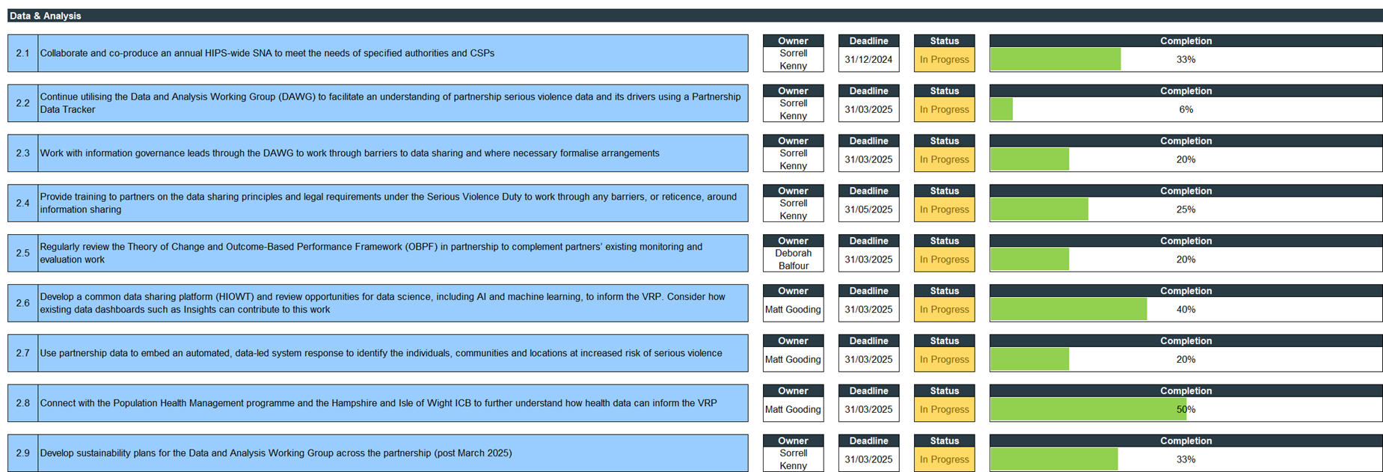
Data & Analysis

Slide 13
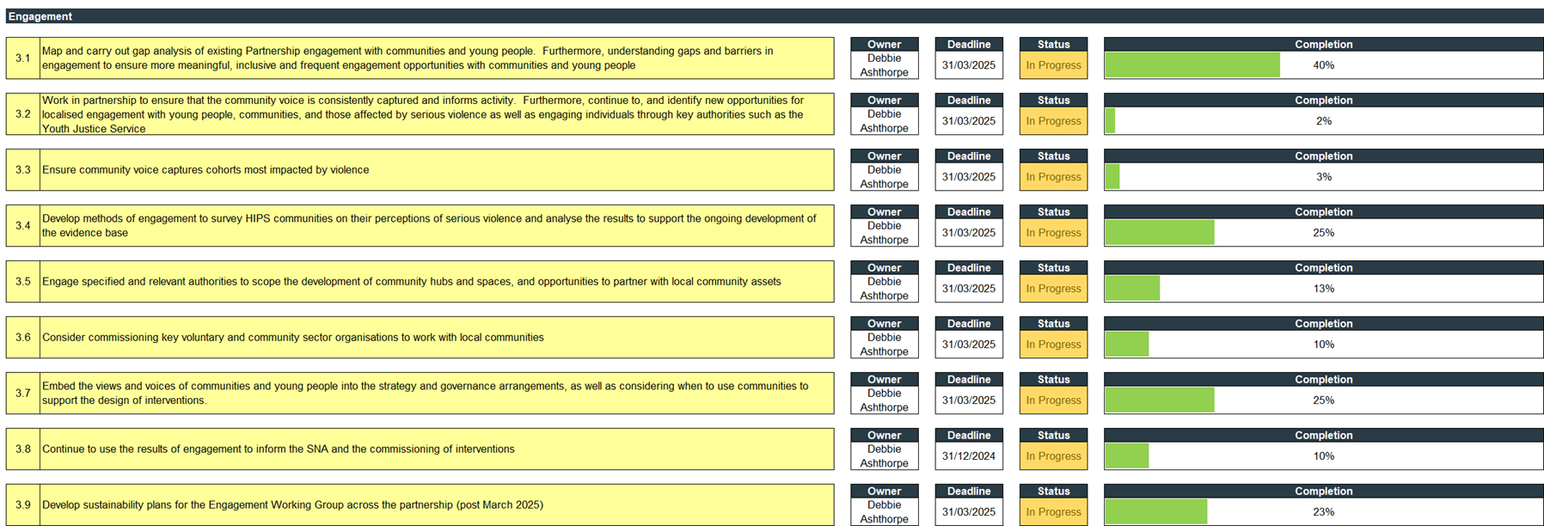
Engagement

Slide 14
Communications

Slide 15
Interventions, Evaluations and Opportunities

Slide 16
Tactical Violence Reduction Partnership Update
Presentation from Serious Violence Dashboard by Serious Violence Analyst

Slide 17
Violent Crime Taskforce Update
Supported a number of operations across HIOWC over the last three months with continued focus on Serious Violence hotspots, Serious Violence perpetrators and Habitual Knife Carriers (HKCs):
Month of focus on outstanding suspects – involved in the arrests of twelve individuals
Operation Sceptre – week of enhanced focus on knife crime
Operation Suspend – long-term Robbery problem in St Marys, Southampton
Clear Hold Build in Gosport
Operation Whiteheart – Serious Violence and ASB related shoplifting in Basingstoke
Operation Gatewatch – Serious Violence and ASB related shoplifting by HKCs in Shirley, Southampton
Operation Nautical – ASB by HKCs in Southsea, Portsmouth
Operation Sanday – Serious Violence and ASB related shoplifting in Ryde, IOW
Future plans:
Three Permanent Surrender bins to be placed in Southampton
Work with Licensing to reduce knife crime in Night Time Economy.

Slide 18
Op Sceptre Results – May 2024
Highlights
Focus on Habitual Knife Carriers; 5 arrests made and 40 diversion visits carried out. HKC packs given to HKCs / their parents detailing possible sentences, increased likelihood of becoming a victim and signposting to relevant partners for support and information
Continued focus on opportunities for the surrender of knives with bins now permanently placed in all front offices. Very positive community engagement with mobile surrender bins and collections of knives from those unable to get to stations
Increased School engagements prioritising those in or near hotspots
Increased partnership engagement across the two counties, due to joint campaign and planning with the VRU.
Learning
Planning to start earlier for next Op Sceptre (11 - 17 November 2024) to enable partners and wider internal teams to engage
Sceptre to become a national brand focussing on collaboration with partners and communities, prevention and intervention; with a specific emphasis on encouraging forces to identify, deter, deflect or disrupt those engaged in knife carrying. Weeks of action will continue for enhanced focus
Plans in place for national surrender of Zombie-style knives and machetes 26th August – 23rd September 2024.

Slide 19
GRIP Funding Update
HIOW will receive almost £1.5 million for Serious Violence and ASB hotspot policing for 2024-2025. £750,000 allocated to partners – £37,500 per hotspot
Home Office expectation that 9,000 – 13,000 hours of visible patrolling per £1million spend; approximately 13,500 – 19,500 for HIOW
Form developed for partners to complete at the end of their patrols that feeds into the PowerBi
Hotspot patrols by partners in place in Fareham and Gosport, Portsmouth and Rushmoor. 31 patrols already completed
Returns to the Home Office required monthly detailing number of visible patrol hours, total arrests, total stop searches and total number of ASB powers used – includes issuing of FPNs, CPNs and CPWs, PSPO enforcement
Quarterly returns to the Home Office to include specific details around patrols in each hotspot, numbers of ASB incidents and details of problem-solving activity, as well as funding claims.

Slide 20
Data & Analysis Update
New VRU Analyst in post since May 2024 – a secondment from the OPCC
£38.7K has been allocated for co-production of the SNA process across the HIPS area – IOW are in further discussions to co-ordinate the process in 2024
Current focus of the DAWG is to progress data sharing between Specified Authorities for the SNA, being monitored through Partnership Data Tracker & Outcomes Based Performance Framework.

Slide 21
Hampshire & Isle of Wight Together Update
Adoption of TVT / HIOWT into Police JIMU to improve resourcing
New Data Engineer starting
VRP Teams Channel to improve collaboration
Exploration of other data sharing options in the interim
Working groups commencing to begin sign up processes:
HIWFRS
Portsmouth City Council
Southampton City Council
Hampshire County Council
IoW Council
SCAS (Jointly with TVP)
Probation (Jointly with TVP)

Slide 22
Communications Update
Short
Comms & Engagement working groups to develop Communications Strategy and campaign calendar
Create VRP brand
Medium
Create VRP website and launch this to communicate with partners and the public
Celebrate and highlight the work of communities and the VRP working together to meet the Serious Violence Duty (Op Sceptre)
Long
Celebrate the work of communities and VRP working together
Develop a strength-based counter-narrative, including opportunities for co-production with communities
Develop a sustainable model for VRP Communications & Engagement.

Slide 23
Engagement Update
Short
Map existing partnership engagement with communities and young people
Understand gaps and barriers, to ensure more meaningful inclusive engagement
Localised engagement with communities and young people
Medium
Develop methods of engagement to survey HIPS communities
Ensure community voice captures cohorts most impacted by violence
Use this data to develop an evidence base
Consider key VCSE organisation to work with local communities
Long
Consistent method to survey HIPS communities
Results inform SNA, activity, and commissioned services
Embed views into the Response Strategy & governance arrangements and communities should support design of interventions
Partners develop community hubs & spaces, and opportunities to partner with community assets.

Slide 24
VRP Campaigns, Awareness & Events Calendar
What is it?
A partnership calendar everyone can access to collaboratively share content
Link the focus to Serious Violence
Why?
Celebrate and highlight the work of communities and the VRP working together, including meeting the Serious Violence Duty
Develop a strength-based counter-narrative, including opportunities for co-production with communities
Develop a sustainable model for VRP Communications and Engagement
What’s next?
May – Op Sceptre
June – Euros ‘Walk Away’ Campaign
July – 1st - 7th ASB Week
August – ‘Is Your Child Safe?’ (PCC)
September – International Day of Charity (Seeking lead agency)
VRU to produce a ‘Serious Violence content support library’.

Slide 25
Interventions, Evaluations & Opportunities Update
VRU Intervention Figures for 2023/2024 – A & E Navigators

Slide 26
VRU Intervention Figures for 2023/2024 – Choices

Slide 27
VRU Intervention Figures for 2023/2024 – RESET

Slide 28
VRU Intervention Figures for 2023/2024 – TIPs

Slide 29
VRU Intervention Figures for 2023/2024 – Reach

Slide 30
VRU Interventions Next Steps
Currently the majority of interventions are due to end in March 2025
The A&E Navigators are managed and match funded by Health and is currently on a contract tender waiver to No Limits which will need to end. The ICB is re-structuring causing uncertainty and the contract would have to go out to tender which would lead to a significant break in service
Choices (Year 6&7) will end at the end of academic year in July 2025. There is an option for the provider to take on Choices and sell to schools, this would need to be agreed by the PCC
The end of the two year evaluation for the four VRU funded interventions is due in March 2025 – An interim report (Year 1) for RESET is due in mid-June 2024
Sustainability options will be explored for all VRU Grant funded interventions.

Slide 31
IEO Sub-group Update
A survey is being conducted with YJS practitioners and with CSPs across the HIPS area to understand the gaps in provision for supporting children at risk of Serious Violence
Hampshire Public Health will present to the IEO Sub-group the survey findings from professionals to support the gap analysis
An in-person workshop will be delivered in the summer to the IEO sub group on co-commissioning and partnership resources by an external VRU partner
Development of Commissioning resources on the VRP website for professionals to access, including funding opportunities, previous bids, and evaluation of interventions.

Slide 32
Workforce Development

Slide 33
Serious Violence Toolkit Launch 19/03/2024
412 attendees
Learning level post = 7.76 (rise by 1.5 points)
Delegates said they:
Will use the Toolkit in their roles to help support the families
Share the Toolkit with their teams to raise awareness
Use it as a reference point should they have any concerns around the subject and are now aware how to refer / report
Signpost families for support as well as being used to support themselves and their teams in their roles
Have a greater understanding of the subject and are now more aware of how partner agencies work together as well as the individual roles of the agencies.
This is now the most used Toolkit of all the HSCP Toolkits
Three scheduled Serious Violence webinars for HIPS professionals in May, October and February 2025.

Slide 34
Ben Kinsella Trust Training
120 attendees
Learning level post = 7.10 (rise by over 2 points)
Feedback:
Brilliant and engaging
Useful, authentic delivery
Need more training like this
Informative, good resources and support

Slide 35
Development of Serious Incident Toolkit
What do we all do when a serious incident occurs?
We need your help!

Slide 36
Any Other Business
Violence Reduction Unit - Hampshire Police and Crime Commissioner (hampshire-pcc.gov.uk)
Thank you!

