Slide 1

Information Sharing and the Serious Violence Duty

Slide 2

Serious Violence Duty
Introduced under the Police, Crime, Sentencing and Courts Act 2022​ (PCSC Act 2022)
The aim is for specified authorities to work together to share information and target interventions to prevent and reduce serious violence.
Specified Authorities:
  Police
  Fire
  Probation
  Youth Justice
  Health
  Local Authorities
Relevant Authorities:
  Education
  Custody

Slide 3
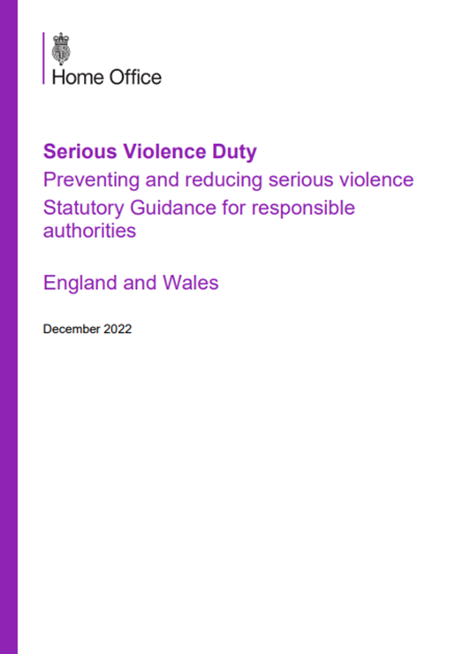
Serious Violence Duty
The Serious Violence Duty Guidance (p. 18) outlines the core elements of what specified authorities are expected to do once a partnership structure has been identified:
  Understanding local issues: In order to identify the kinds of serious violence that occur in their areas, and so far as it is possible to do so, the causes of that serious violence, the partnership should work together to establish the local ‘Strategic Needs Assessment’ – identifying the drivers of serious violence acting in the local area and the cohorts of people most affected or at risk. This will require the sharing of relevant data and useful information held by the individual organisations subject to the Duty.

Slide 4

The Hampshire, Isle of Wight, Portsmouth and Southampton (HIPS) Violence Reduction Partnership (VRP) recognises the importance of effective multi-agency information sharing to prevent and reduce Serious Violence by identifying the drivers and people most affected or at risk of Serious Violence (Strategic Needs Assessment).
This guidance shows how the legislation, specifically the Police, Crime, Sentencing and Courts Act 2022, includes provisions to support partners to share information, intelligence, and knowledge around Serious Violence.
Sharing data saves lives and reduces demand!

Slide 5

Effective information sharing has been a focus for Health through the ‘Information Sharing to Tackle Violence (ISTV)’ approach and by Violence Reduction Units (VRUs).
There are three recognised levels of information usage in order to support work to prevent and reduce serious violence:
Level 1 – Information used to inform the Strategic Needs Assessment in order to understand local issues
Level 2 – Information used to better identify hotspot locations and support a targeted approach
Level 3 – Information used to better identify individuals at risk for high-intensity support programmes (Level 3 data would not apply for healthcare data under the Duty).

Slide 6

The PCSC Act 2022 does not affect existing information sharing gateways but provides an additional power to share information between authorities:
Section 16 PCSC Act 2022 – Provides a permissive information sharing gateway that enables specified authorities, local policing bodies (PCCs or equivalents), educational, prison and youth custody authorities to disclose information to each other for the purposes of their functions under the Serious Violence Duty.
Section 17 PCSC Act 2022 – Creates a power for local policing bodies (PCCs and equivalents) to request any specified authority, educational, prison or youth justice authority within its police force area to supply it with such information as it may specify for the purpose of its functions relating to the Serious Violence Duty. The purpose of this power is to enable or assist local policing bodies (PCCs or equivalents) to assist a specified authority in the exercise of its function to collaborate and plan to prevent and reduce serious violence and monitor the local strategy and its effectiveness.
Sections 16 & 17 PCSC 2022 – Personal information may be disclosed by specified authorities except health and social care authorities who should be aware that there are restrictions under the powers on the disclosure of patient information and/or disclosure of personal information by a specified health or social care authority. These restrictions mean that generally they cannot be required to disclose confidential patient information. Any sharing of personal information must comply with data protection legislation (most importantly, the Data Protection Act 2018), ensuring that it is necessary and proportionate for the purpose.

Slide 7
Information Sharing Considerations
Data Protection – Responsible authorities may already have arrangements in place that clearly set out the processes and principles for sharing information internally, and arrangements for sharing information within local partnerships arrangements and with external bodies, including sharing personal data where permitted.
  Key legislation: Section 3 Data Protection Act 2018
  Key legislation: UK General Data Protection Regulation 2016
Information Sharing Agreements (ISAs) – For the purpose of the Serious Violence Duty, existing Community Safety Partnership (CSP) ISAs may cover the arrangements which make it clear that the purpose of sharing the information is to facilitate a reduction in crime and disorder and for the appropriate support and interventions for individuals to be put in place.
  Key legislation: Section 115 Crime & Disorder Act 1998

Slide 8

Serious Violence Duty Guidance
For further guidance: Data and Information Sharing (Chapter 2, paragraphs 168 – 196, pages 57 – 65)
Serious Violence Duty - GOV.UK (www.gov.uk)

