Slide 2
Welcome & Housekeeping
Lisa Allam
Head of Commissioning (OPCC)

Slide 3
Event Opening
Donna Jones
Police & Crime Commissioner for Hampshire & Isle of Wight

Slide 4
Introduction to the National Stalking Consortium 12th February 2025 Catherine McLaughlin
Director of Services and Development
Suzy Lamplugh Trust

Slide 5
Who was Suzy Lamplugh?
Estate agent​​​
​25 years old​​​
Appointment at 12:40pm, 28th July 1986, with ‘Mr Kipper’
Disappeared (presumed murdered)​​​
6:45pm manager reported Suzy missing to police​​​
Declared dead in 1993​
Notes:
Before we start, I would like to give a brief overview of SLT, for those of you who are not aware of who we are and why we are here​
The Trust was set up in 1986 by Paul and Diana, the parents of Suzy Lamplugh​
At 12.40pm on 28th July, Suzy had left her office, Sturgis and Sons, 654 Fulham Road, taking her house and car keys and a purse with £15 and credit cards, but leaving her handbag behind. Ten minutes later she was seen waiting outside an empty property, 37 Shorrald’s Road which had only been on the market for one week.
At 1.00pm she was joined by a man (presumably the “Mr Kipper” she had written in her diary) who was dressed “immaculately – as if he’s used to it” and minutes later they were seen walking away from the house.
At 6.45pm her manager reported Suzy’s disappearance to the police. She was officially declared dead, presumed murdered, in 1993.
Suzy's parents believed that she had been stalked, and this is what led to our long history of campaigning in this area.​

Slide 6
Our work includes
Support​
National Stalking Helpline (supported over 75,000 victims to date)
Advocacy Service​
Online tool​
London Stalking Support Service​
MASIP​
PATHs Model​
Educate​:
Workplace Training & Consultancy​
Bystander Training​
Publishing guidance​​​​
Stalking Awareness Training​
Lifeline Stalking Training
Campaign​:
Raising awareness​​​​
Influencing policy makers​​​​
Working with partners​
National Stalking Consortium​
Notes:
Suzy Lamplugh Trust is widely regarded as a field expert in lone-working and personal safety training, stalking training, as well as consultancy, campaigning, and support services. ​
It has a long history of working within the Violence Against Women and Girls sector, dealing particularly with stalking and harassment, given that it is believed, and indeed the evidence suggests Suzy may have been targeted by a stalker. ​
The National Stalking Helpline was set up by the Trust in 2010, it has helped over 75,000 victims since its inception and is the only service of its kind globally.​
The Trust campaigns heavily to raise greater awareness of personal safety and stalking issues, demand systemic change where needed, influence public policy, and promote a society in which people are safer and feel safer.​
Its longest running campaign has been the licensing of the operators and drivers of minicabs and private hire vehicles, which begun in 1998. This campaigning and policy work has been pivotal to changes in legislation and practice nationally - including in the introduction of the Protection from Harassment Act 1997, and the Protection of Freedoms Act 2012, which introduced specific offences for stalking, and the 2020 stalking protection orders.​

Slide 7
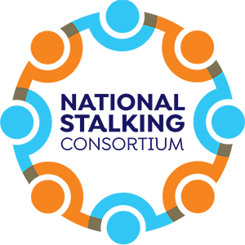
National Stalking Consortium
Formed in 2014
Made up of 21 specialist stalking organisations and individual members
Shares best practice and information
Ensures victims’ needs are at the forefront of both frontline and statutory services
Collaborate across campaigns including our annual NSAW campaign
Notes:
The National Stalking Consortium was formed in 2014 and since then we have worked together to support victims of stalking, share information and hold criminal justice agencies to account. ​
It is made up of 21 specialist stalking organisations and individual members including victims and academics from across the U.K.
Meeting quarterly, it plays a crucial role in terms of sharing best practice, identifying patterns of stalking behaviour and ensuring victims’ needs are always kept at the forefront of both frontline and statutory services across the country by providing a united voice within the sector.
Every year, we collaborate on a National Stalking Awareness Week campaign that sheds light on issues relating to victim/survivors of stalking, pushing decision makers in the criminal justice system and the government to improve provisions for stalking victims. ​
As members we have lobbied collaboratively on vital issues such as the removal of parental alienation from the Domestic Abuse Statutory Guidance (2021) and on concerns to changes around post separation control within the Coercive and Controlling Behaviours Statutory Guidance (2022). ​
Significantly, we submitted a super-complaint at the end of 2022 that found systemic issues in the police response to stalking, which was investigated by the IOPC, HMICFRS, and the College of Policing.

Slide 8
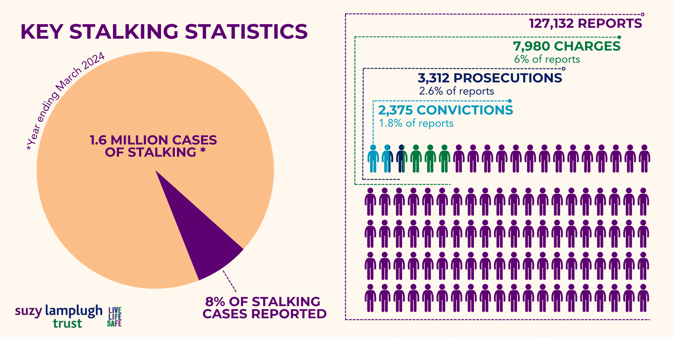
What is stalking?
​Stalking is a pattern of fixated and obsessive behaviour, which is intrusive and causes fear of violence or engenders alarm and distress in the victim
Notes:
SLT defines stalking as “a pattern of fixated and obsessive behaviour, which is intrusive and causes fear of violence or engenders alarm and distress in the victim.”​​
Stalking behaviour is unwanted, persistent, and it is almost always carried out (or orchestrated by) one individual towards another individual​​. ​​
Stalking can include many types of unwanted behaviour, online or in-person and will affect approximately 1 in 5 women and 1 in 10 men in their lifetime. It can lead to feelings of depression, anxiety and even post-traumatic stress. It is often described as a crime of psychological terror.​
Stalking is a widespread crime, impacting an estimated 1.6 million people in the year ending March 2024 in England and Wales​.
Of those only 8% end up reporting to the police. Only the equivalent of 1.8% of reports of stalking to the police end up in a conviction.

Slide 9
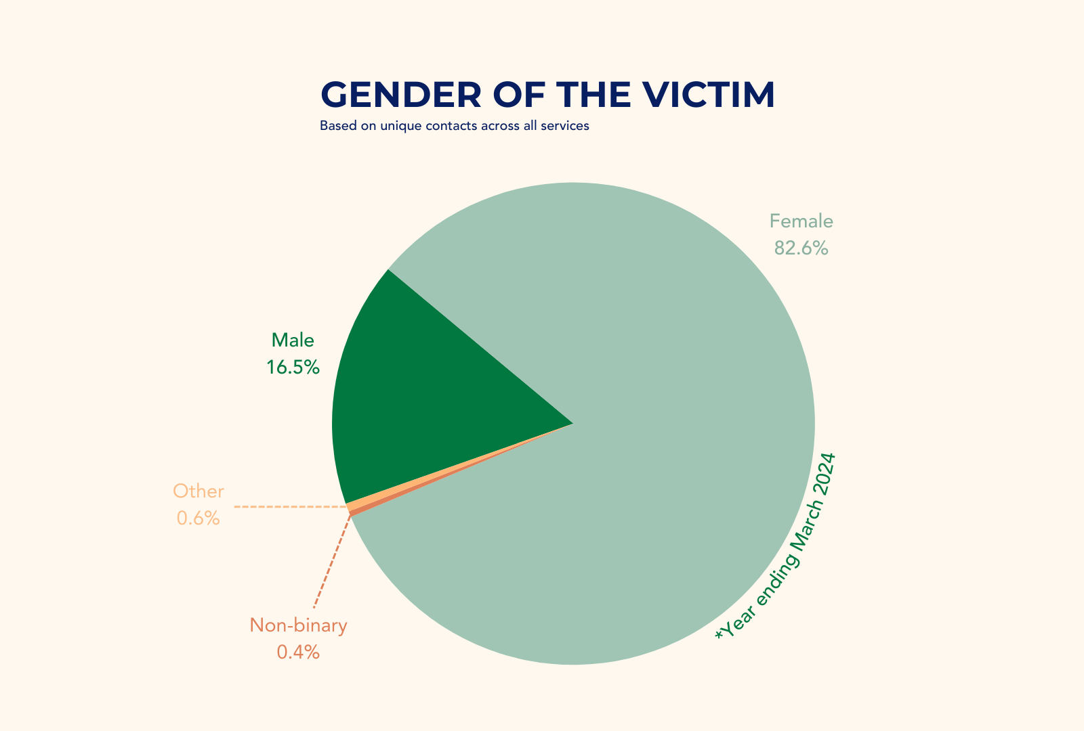
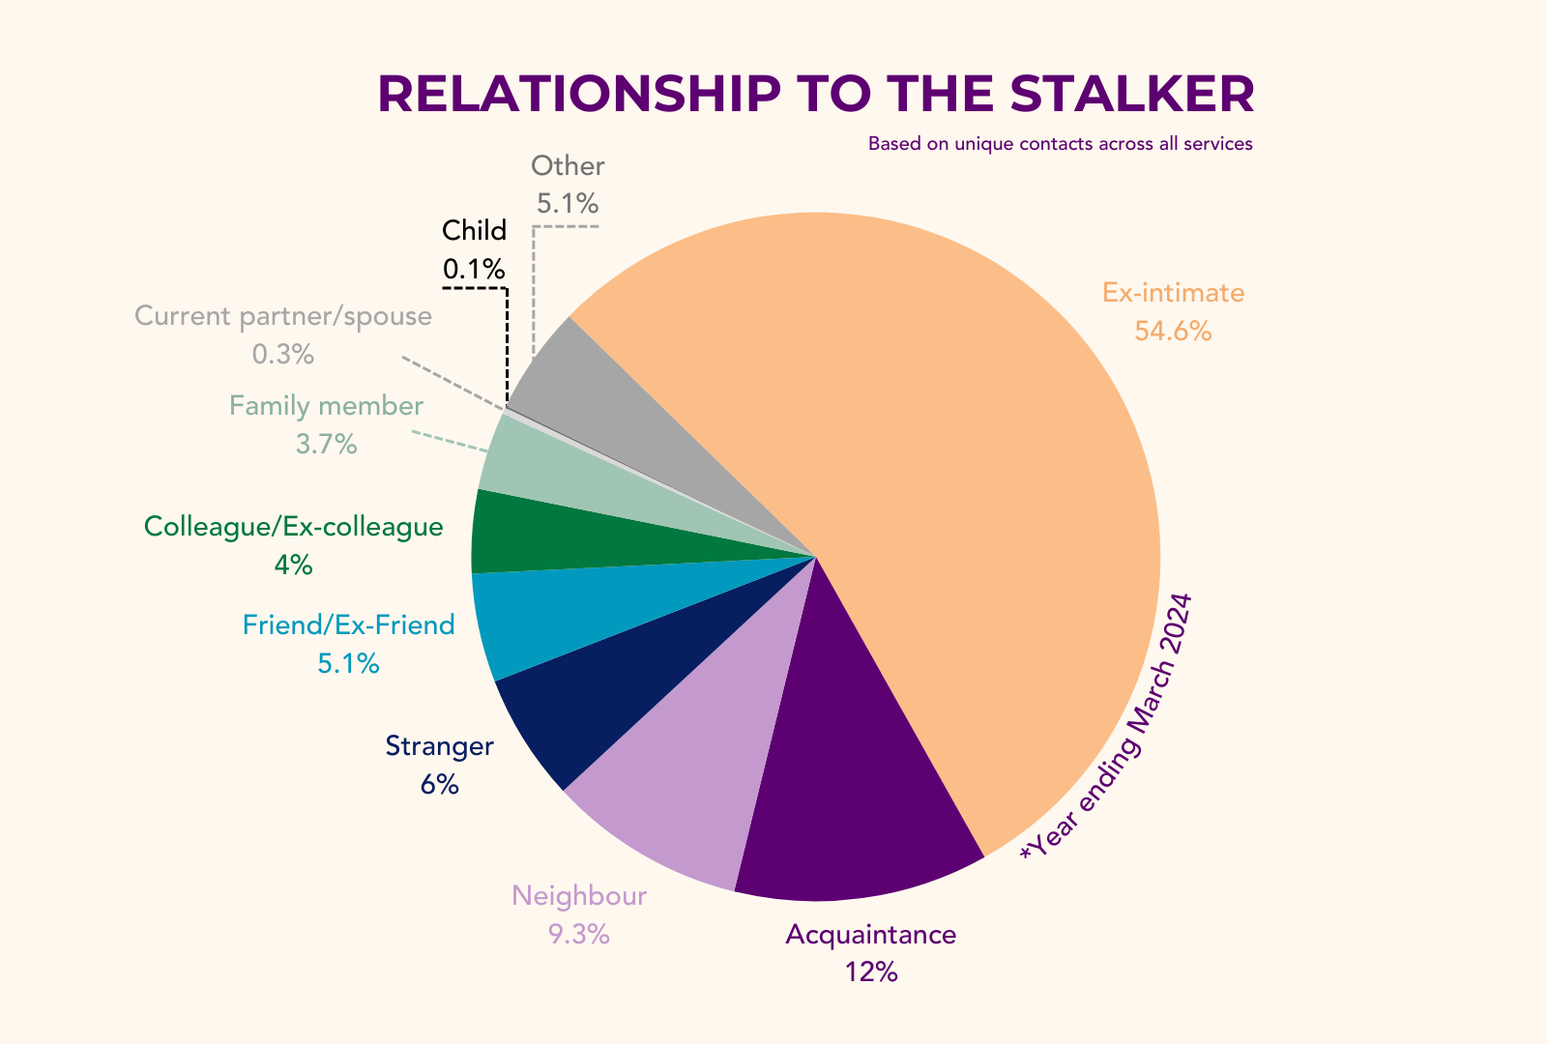
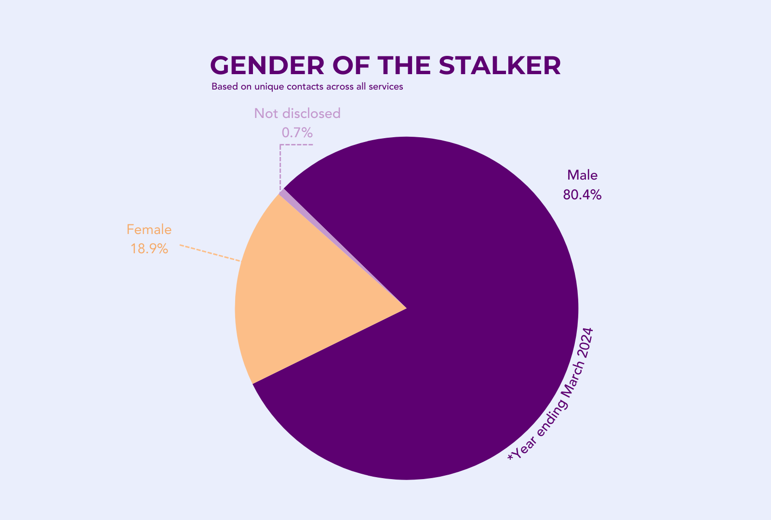
Notes:
As you can see, according to data from Suzy Lamplugh Trust’s advocacy and frontline services for the year ending 2024, the majority of victims we support are female whereas the majority of their stalkers are male.
Around half of the victims we supported in the year ending March 2024 were stalked by an ex-intimate partner. The other half were stalked by a number of different people, including acquaintances, strangers, neighbours, friends, colleagues, etc.

Slide 10
Key Issues
Misidentification of stalking (i.e. police behaviours as single, unconnected incidents or as different offences)
The police failing to recognise the risk of serious harm or homicide to the victim, the psychological effect of stalking or online behaviours as part of the stalking
Poor use of Stalking Protection Orders by police forces
Lack of referrals to specialist stalking services
The urgent need for efficient multi-agency working to address stalking
In 2022, we submitted a super complaint highlighting some of these systemic issues
Notes:
This woeful conviction rate highlights the challenges victims face when navigating the criminal justice system.
We know that to ensure that victims can reach the outcome they deserve as well as receive the support they need, it is crucial that stalking behaviours are recognised as early as possible.​
We know that victims can find telling someone about their experiences extremely difficult. It is vital that agencies who may be the first point of contact for many victims, such as police or healthcare professionals, are able to identify stalking behaviours and refer victims on to specialist stalking services. ​
It is also key that frontline police officers are able to recognise stalking and believe victim at this critical stage in their journey to justice. For many victims, this is unfortunately not the case.
This is why, in 2022, the National Stalking Consortium submitted a super complaint highlighting some systemic issues such as:
The police failing to identify stalking and either treating behaviours as single incidents or charging them as a different offence entirely (like malicious communications/harassment)
The police failing to recognise the risks to victims or having a poor understanding of how behaviours might impact the victim
Police failing to use Stalking Protection Orders which were brought in in 2020 and can be a vital safeguarding tool for victims of stalking by putting in place prohibitions, as well as positive requirements on perpetrators, such as attending a mental health assessment or surrendering devices for evidence collection.

Slide 11
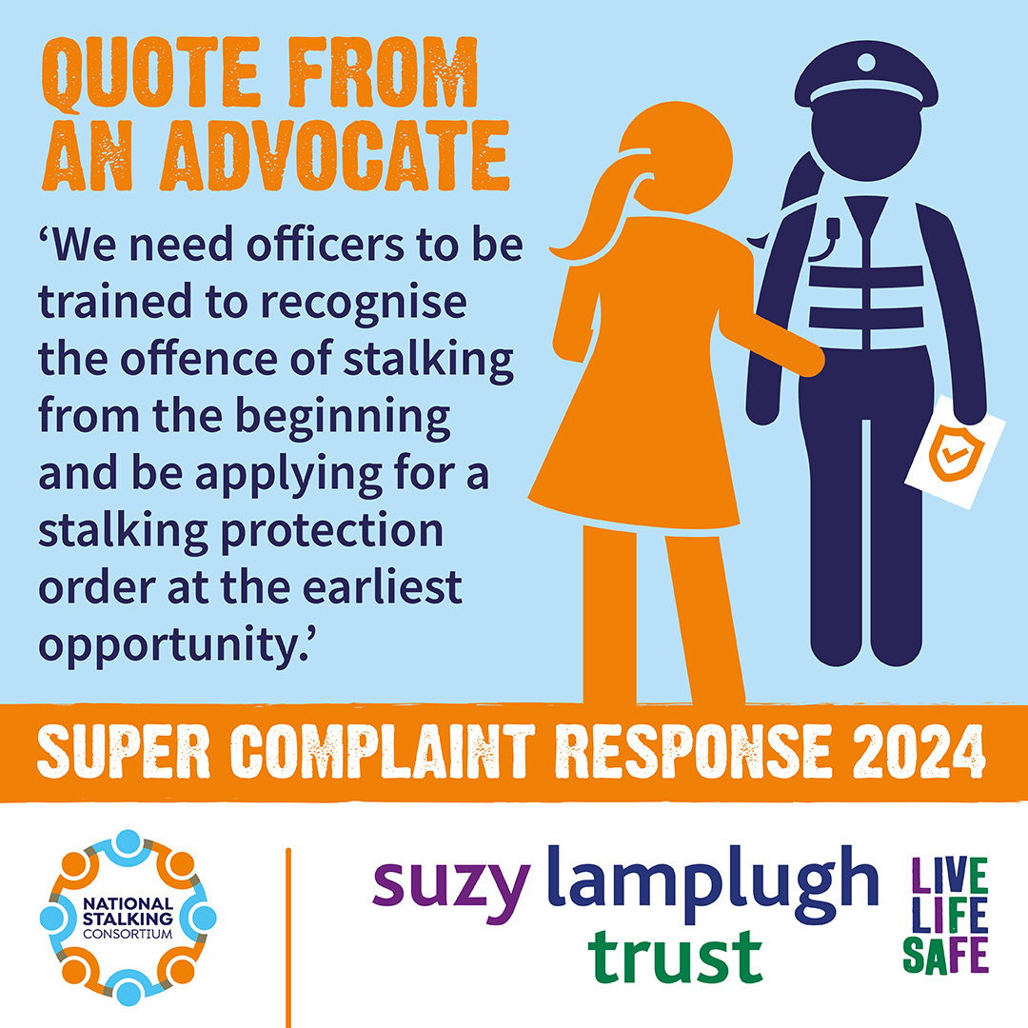
Super Complaint report
In September 2024, the investigative committee published its report in response to the Consortium’s super complaint on the police response to stalking.
Significant changes are needed to improve police responses to reports of stalking.
The report issued 29 recommendations to ensure better support for victims across the police and the CPS.
We hope this investigation and the forces’ published action plans lead to real positive change
Notes:
The super-complaint was a landmark moment for the sector.
In September 2024, the committee investigating the National Stalking Consortium’s 2022 super complaint issued its report which stated unequivocally that the IOPC, HMICFRS and the College of Policing found clear evidence supporting the claims made in our original report.
These included multiple systemic issues relating to the police response to stalking, from police minimising or trivialising stalking behaviours to police failing to recognise online stalking behaviours amongst other issues.
The investigating committee set out in clear recommendations that Chief Constables as well as Police and Crime Commissioners (PCCs), the Home Office, Crown Prosecution Service and National Police Chief’s Council have a duty to take immediate action to ensure that the response to stalking is improved. This was a landmark moment for initiating widespread change to improve the experiences and outcomes for victims of stalking after numerous years of the Consortium raising these issues.
We hope this investigation and the forces’ published action plans lead to real positive change. Victims of stalking cannot afford to wait any longer for change.

Slide 12
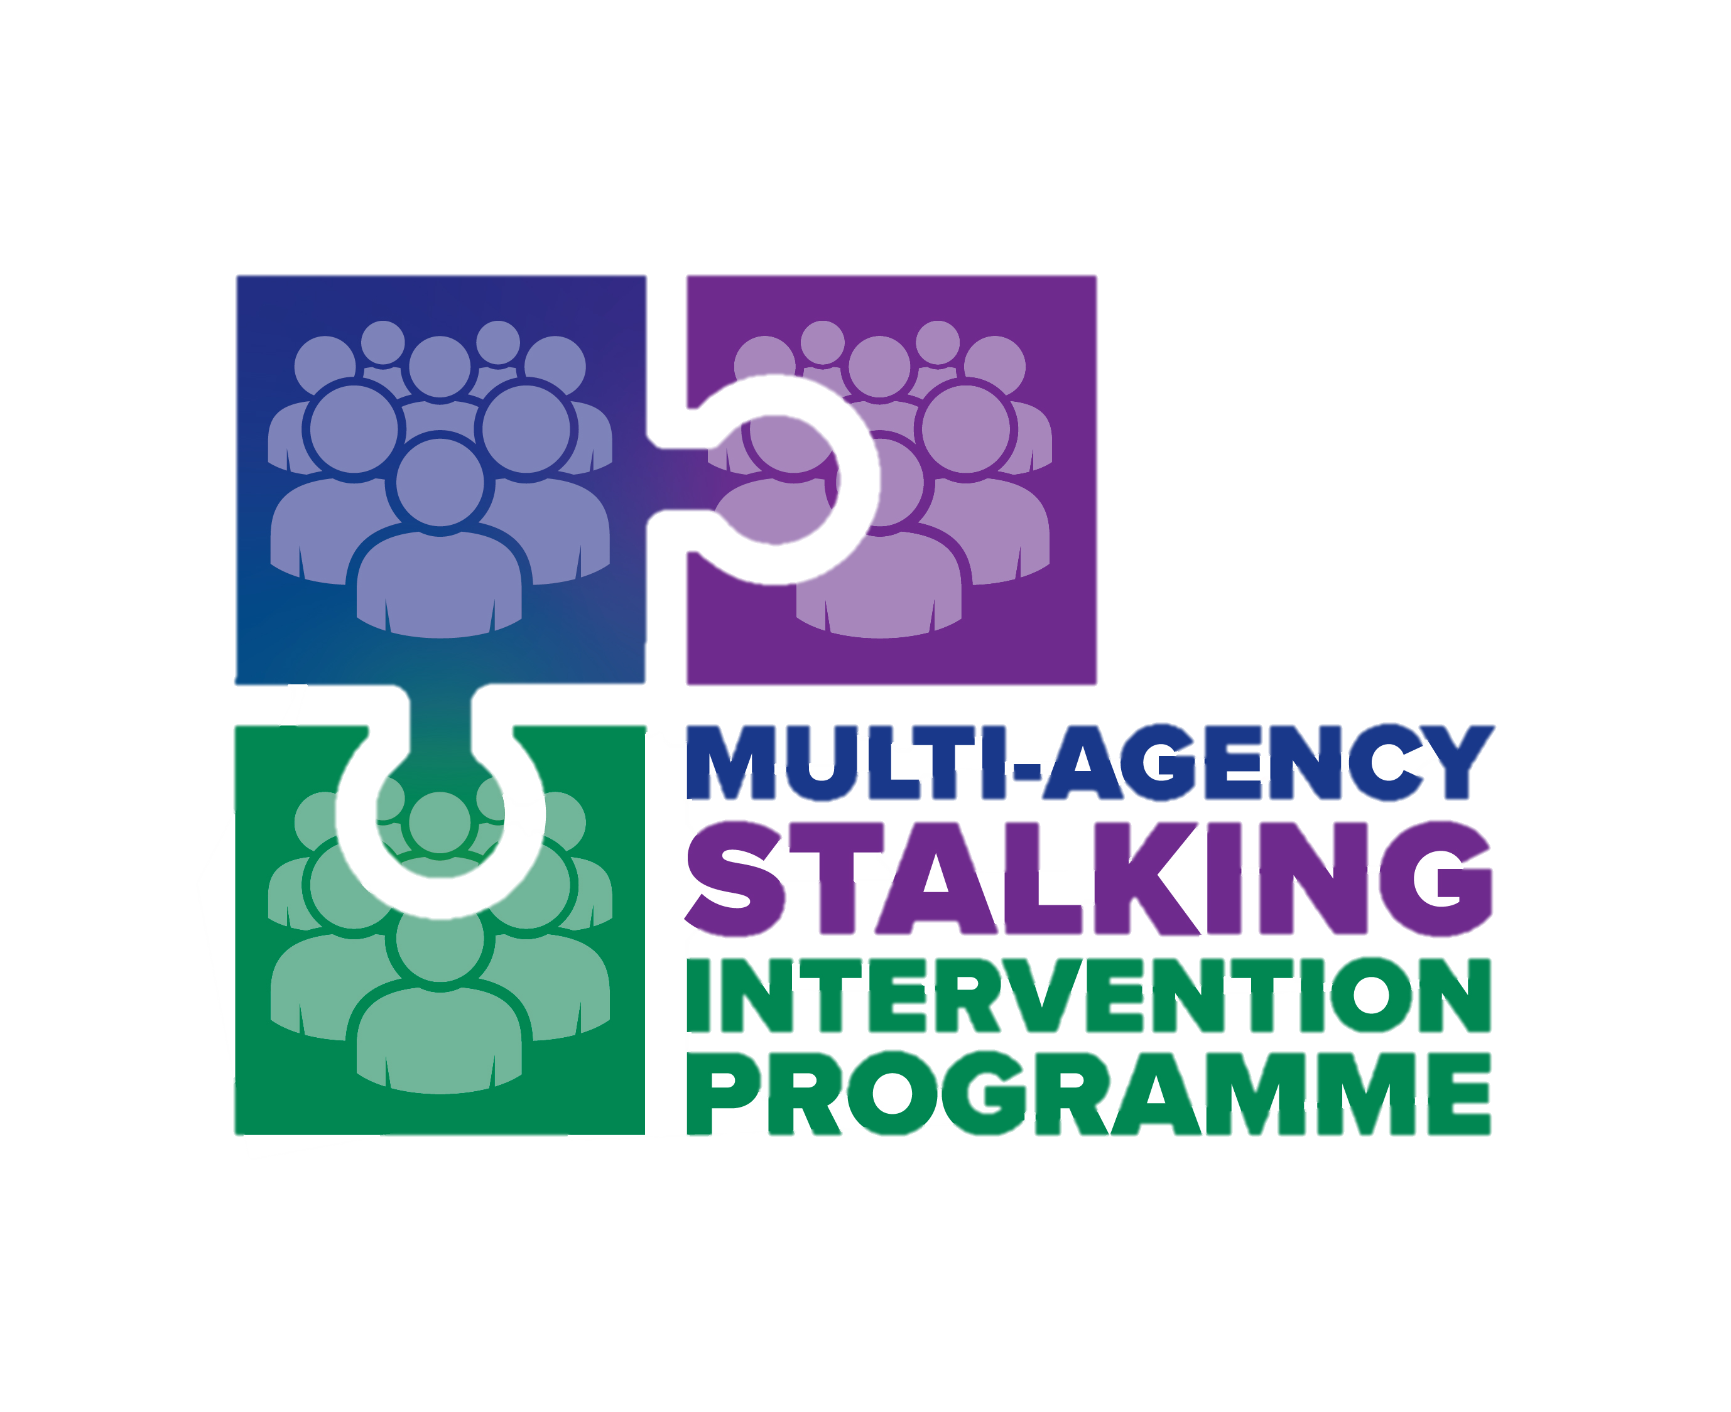
Multi-agency response
A coordinated multi-agency response is necessary to improve the response to stalking cases.
This involves collaboration across government, criminal justice, healthcare, community organisations, the private sector, and the public to address stalking comprehensively.
A Multi-Agency Stalking Intervention Programme offers a bespoke intervention that addresses the needs of victims and perpetrators alike. ​
Hampshire was one of the three original MASIP pilot sites.
Agencies work together in an embedded co-located to ensure early intervention and a robust criminal justice response is paired with perpetrator intervention.​
Notes:
A joint approach across all agencies is needed to improve the response to stalking. We know that agencies work better when they work together.
MASIPs enable efficient embedded joint working across police, probation, health and advocacy. This not only ensures that victims are appropriately safeguarded but also that information can be exchanged easily between agencies and support services.
Hampshire was one of the three original MASIP pilot sites (alongside STAC in London and Cheshire Harm Reduction Unit in Cheshire)
This is quite different from multi-agency meetings and is a co-located model ensuring experts across all agencies assess cases together as they come in to manage the risk of escalation at the earliest possible opportunity.​
MASIPs remain victim-centred and trauma-informed throughout to ensure robust risk management from the earliest opportunity.​
MASIPs should form only one part of a whole society response to stalking that seeks to improve the overall criminal justice response to the crime but also push for cultural change that could lead to long-term prevention and education.

Slide 13
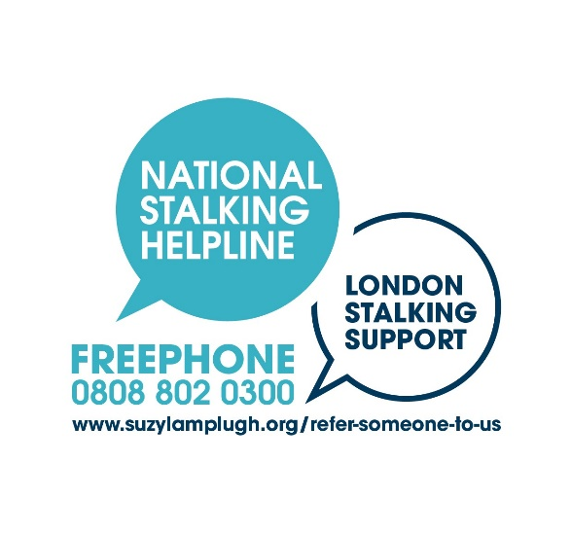
FOR MORE INFORMATION …
training@suzylamplugh.org
advice@stalkinghelpline.org
www.suzylamplugh.org
www.stalkinghelpline,org
Suzylamplughtrust
stalkinghelpline
@life_life_safe
@talkingStalking

Slide 14
What is non-intimate stalking?
Examining typologies other than rejected
Dr Kirsty Butcher, Principal Clinical Psychologist & Clinical Lead, MASP

Slide 15
Overview
The psychology of stalking
The different types of stalking behaviour
Motivations behind these behaviours
Associated clinical and risk factors
The implications for police, probation officers and mental health teams working with each typology
Case studies of each typology and a description of our work with them
What is non-intimate stalking? Dr Kirsty Butcher, MASP, HIOW NHS Trust, 12.02.2025

Slide 16
Be kind to yourself ….
1 in 5 females & 1 in 10 men will be stalked in their lifetime
(Home Office, 2023)
People who work in healthcare, social work and the criminal justice system are at increased risk of stalking, especially from people who may hold a grudge due to our work
So, if this presentation or anything during the day triggers difficult memories or feelings; listen to yourself, take a break, take some space
Talk to me, the health team or the victim advocates if needed
Contact stop domestic abuse (0330 0533 630), or National Stalking Helpline (0808 802 0300) for further support
What is non-intimate stalking? Dr Kirsty Butcher, MASP, HIOW NHS Trust, 12.02.2025

Slide 17
Stalking behaviour is a symptom of underlying issues
The psychology of stalking
Notes:
Just like an iceberg, most of what influences our actions lies beneath the surface, unseen by others. The visible tip of the iceberg represents our outward behaviour, what we say and do. The drivers for this behaviour remain hidden beneath the surface.
These are triggered and maintained by certain contextual factors (such as a relationship breakdown)

Slide 18
Contextual issues
Lack of employment
Drug and alcohol issues
Ongoing contact with victim
Lack of social support/contact
Stalking is the product of an interaction between context and individual factors such as psychopathology (McKewan et al, 2013)

Slide 19
Mental health and personality issues
Increased rates of mental illness & personality difficulties amongst people who engage in stalking (McEwan & Strand, 2013; Mohandie et al., 2006).
MASP sample (616 referrals 2018-2022)
48% had a mental health diagnosis
16% had two diagnoses
Most prevalent: personality disorders, then anxiety, depression & psychosis
The longer a stalking episode persists & the more intrusive it is, the more likely it is that the individual has mental health difficulties – and these may need attending to upon arrest/within management.
Prominent diagnoses differs according to typology (explained later) (Mullen et al, 2009; McKewan et al, 2013)
However, most people who engage in short term stalking don’t have a mental illness.

Slide 20
Underlying psychological issues
Poor empathy
Sense of entitlement
Impulsivity
Poor emotional control (inc over/under controlled anger)
Poor social functioning
Cognitive limitations
Sexual deviance
Difficulties with rumination
Attachment issues

Slide 21
Adverse childhood experiences
Are a key contributory factor to poor mental health and psychological issues; these affect:
our beliefs about ourselves, the world and others
how we learn to relate to others
how we manage emotions
our response to the end of relationships
Our experience suggests there are increased adverse childhood experiences amongst people who have engaged in stalking, especially relating to attachment issues (which may explain the higher rate of personality issues).

Slide 22
Not all stalking behaviour is the same

Slide 23
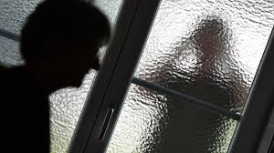
The different types of stalking behaviour (Mullen, Pathe & Purcell 2009)
Rejected
Resentful
Intimacy Seeking
Incompetent Suitor style
Predatory
Unknown
Not all stalking behaviour is motivated by the same issues or should be treated in the same way.
Stalking types differ according to motivation, mental state of the individual & relationship with the victim.
Differences between the stalking types have implications for how you work with them.
Notes:
Unknown category is for when the stalking perpetrator’s identity is unknown (they may not necessarily be a stranger)

Slide 24
Ex-intimate partner stalking: Rejected stalking

Slide 25
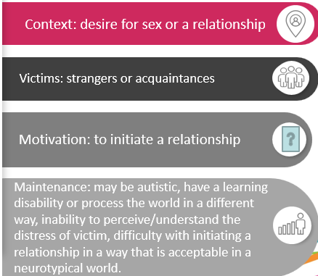
Non-intimate stalking
1. Incompetent suitor style stalking

Slide 26
Clinical factors & risks
Upcoming Deposits
Psychological issues include
Highest recidivism rate of stalking types
Often brief pursuit then onto next victim
Having a learning disability
Being autistic
Unless they know the victim, in which case the behaviour can persist
initiating a relationship in a way that is not accepted in a neurotypical world
Mullen et al (2009)
Difficulty understanding the perspective of the victim/distress caused

Slide 27
Most prevalent mental health diagnoses according to typology (616 MASP referrals 2018-2022)
Rejected
Personality issues
Resentful
Personality issues
Incompetent suitor style
Personality issues
Anxiety disorders
Learning disability
Intimacy seeking
Predatory
Psychosis
Personality issues
Depression
Psychosis
Autism
Notes:
This summarises the most prevalent diagnoses according to typology.

Slide 28
Implications for policing
Other offences
There may be previous victims who have not wanted to notify the police
Upon arrest
Be aware of possible learning disability or that the person may be autistic
Ask them if they have any issues with understanding or any sensory issues
May need an appropriate adult in the interview
Refer to HLDS

Slide 29
Implications for policing/management
Ask whether they need any adjustments to be made (e.g. move to a quieter room)
Use language that is easy to understand (no jargon, no metaphors).
Use short sentences
Check that they have understood what you have said by asking them to repeat key elements back to you
They may feel overwhelmed and unable to think clearly, give them time
See www.autism.org.uk for:

Slide 30
Implications for mental health treatment We need to tailor treatment according to MH issues within each typology + individual formulation
Rejected
Resentful
Incompetent suitor style
Intimacy seeking
Predatory
Amelioration of problematic personality issues, attachment issues, depression and anxiety disorders (the feeling of being unsafe in an unsafe world when outside of a relationship)
Amelioration of problematic personality issues, anxiety and depression
Treatment needs to encompass social skills and accommodate issues connected with autism & learning needs, as well as consider problematic personality issues
Higher incidence of psychosis suggests these cases need to be referred for psychiatric assessment early in the criminal justice process (important as stalking often persists for as long as delusion does so treatment reduces risk)
Treatment aimed at amelioration of problematic personality issues
May be longer term due to severity of difficulties
Notes:
This would include …..

Slide 31
Incompetent suitor style stalking case example: John’s journey into MASP
Complaints to police of John harassing females in charity shop
Police reviewed case – no violence, stalking 2a, admission of guilt in interview.
Caution given & OOCD team notified who reviewed case & notified HIOW NHS team
HIOW NHS team provided 9 PLSI Skillsbuilder sessions
What is non-intimate stalking? Dr Kirsty Butcher, MASP, HIOW NHS Trust, 12.02.2025

Slide 32
Incompetent suitor style stalking case example: John’s engagement with PLSI
Background
John is autistic & has a learning disability
He lives in supported accommodation, is single, unemployed, and has a support worker to help him with activities of daily living
John got into trouble after visiting local charity shops and harassing specific females within the shop. When they did not respond to his attempts at conversation as he had hoped, he became aggressive and threatening. He would attend the shop on numerous occasions looking for them.
John mentioned numerous occasions of harassing females over several years.
What is non-intimate stalking? Dr Kirsty Butcher, MASP, HIOW NHS Trust, 12.02.2025

Slide 33
Incompetent suitor style stalking case example: John’s engagement with PLSI
Intervention
John understood the basics of what was appropriate within different types of relationships, however, he would disregard these when he felt judged, mistreated, or rejected.
Anger played a significant role in John’s unwanted contact, but he struggled to connect physically with the feeling of anger.
Therefore, a rule-based approach to new interactions was implemented, plus a traffic light system for interpreting the situation (green = safe situation, amber = a situation where he doesn’t understand what to do, red = an unsafe situation that he needs to remove himself from).
John also learnt skills such as being present in his body to assist with calming anger, ‘surfing the urge’ for when he felt the urge to attend a shop or to see a particular female within the shop and noticing and acknowledging his ruminating thoughts.
What is non-intimate stalking? Dr Kirsty Butcher, MASP, HIOW NHS Trust, 12.02.2025

Slide 34
Incompetent suitor style stalking case example: John’s engagement with PLSI
Outcomes
John attended all 9 of the sessions, accompanied by his support worker.
Positive feedback from John and his support worker
John’s responses to potentially triggering situations improved, and he had been discussing the skills in between appointments.
Post intervention risk measures showed his risk scored remained moderate.
However, the psychological measures suggested his general wellbeing had improved and his mental health had less of an impact on his ability to engage with different aspects of his life.
What is non-intimate stalking? Dr Kirsty Butcher, MASP, HIOW NHS Trust, 12.02.2025

Slide 35
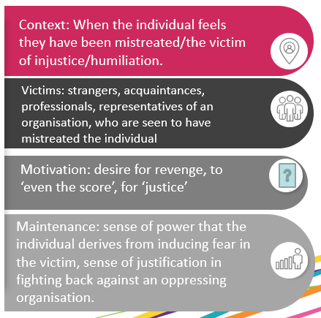
Non-intimate stalking
2. Resentful stalking

Slide 36
Clinical factors & risks
Upcoming Deposits
↑IQ and education compared to other groups
High prevalence of paranoid illnesses
Psychological issues include
Suppressed anger
Defensive, deny behaviour
Mullen et al (2009)
Mullen et al (2009)
Lack social confidence - loners
May be arrogant and narcissistic
Common behaviour
Multiple vexatious complaints
Inappropriate personal contact
Threatening communications
Damaging accusations
Personal vendetta

Slide 37
Most prevalent mental health diagnoses according to typology (616 MASP referrals 2018-2022)
Rejected
Personality issues
Resentful (n=30)
Personality issues
Incompetent suitor style
Personality issues
Anxiety disorders
Learning disability
Intimacy seeking
Predatory
Psychosis
Personality issues
Depression
Psychosis
Autism
Notes:
We also see high rates of anxiety and depression in this group

Slide 38
Implications for policing/management
Likely to be paranoid & suspicious, easily provoked into feeling that they are being treated unfairly
Because they feel threatened, they may respond:
With aggression
By attempting to control the interview, or attempting to get the intellectual upper hand, use overly complex language, denigrate the police/probation officer, provide long, convoluted narrative
By making complaints and threats
May have a rigid thinking style which is difficult to rationalise with

Slide 39
Implications for policing/management
Counteract suspicion – as much as is practicable, increase transparency and explicitly state steps in decision making
Ignore demeaning comments or hostility, do not rise to the bait!
Don’t attempt to challenge their core beliefs underlying the behaviour
If make threats - clearly state consequences of this
Increased likelihood of stalking professionals involved in case, therefore consider co-working case, report any contact from the individual to senior colleagues

Slide 40
Implications for mental health treatment We need to tailor treatment according to MH issues within each typology + individual formulation
Rejected
Resentful
Incompetent suitor
Intimacy seekers
Predatory
Amelioration of problematic personality issues, depression and anxiety disorders (the feeling of being unsafe in an unsafe world when outside of a relationship)
Amelioration of problematic personality issues, depression and anxiety
Treatment needs to encompass social skills and accommodate learning and autistic traits, as well as consider problematic personality issues
Higher incidence of psychosis suggests these cases need to be referred for psychiatric assessment early in the criminal justice process (important as stalking often persists for as long as delusion does so treatment reduces risk)
Treatment aimed at amelioration of problematic personality issues
May be longer term due to severity of difficulties
Notes:
This would include …..

Slide 41
Resentful stalking case example: Simon’s journey into MASP
Referral directly into MASP from NPS Probation Practitioner
Discussed in weekly RAP panel & information shared.
Taken on by HIOW NHS team for PLSI FACT
What is non-intimate stalking? Dr Kirsty Butcher, MASP, HIOW NHS Trust, 12.02.2025

Slide 42
Resentful stalking case example: Simon’s engagement with HIOW NHS team
Background
50-year-old male
Unemployed, lived alone as sole carer for elderly father
Diagnosed with depression
For the previous three years had been stalking his MP due to a dispute he had with British Telecom
Sent threatening emails to the MP, her husband, and her husband’s work colleagues
This led to his arrest and conviction for stalking 2a
No previous convictions
Saw himself as a campaigner of justice & a victim of mistreatment, pursuing this campaign had become his focus in life.
What is non-intimate stalking? Dr Kirsty Butcher, MASP, HIOW NHS Trust, 12.02.2025

Slide 43
Resentful stalking case example: Simon’s engagement with HIOW NHS team
Intervention
Initial consultation and risk assessment with Probation Practitioner, risk of continuing stalking = high, some psychological distress and high levels of rumination on anger
Engaged in 12 sessions, during which he:
Developed an understanding of why he engaged in the stalking behaviour, and how he can avoid it in the future
Explored the workability of the problem behaviours and what function they served in his life (how was they serving him?)
Learnt skills to reduce his rumination about ‘the campaign’, which had prevented him from living a meaningful life
Developed other ways to incorporate his value of justice/fairness into his life
Encouraged connection to other values in his life
What is non-intimate stalking? Dr Kirsty Butcher, MASP, HIOW NHS Trust, 12.02.2025

Slide 44
Resentful stalking case example: Simon’s engagement with HIOW NHS team
Outcomes
Outcome measures indicated although his risk remained high, improvements in psychological wellbeing, mood, sleep, and reduced angry rumination.
By end of the intervention, he had got a job and started a maths evening class.
Acknowledged that he gone about his campaign the ‘wrong way’, said had no intention of contacting the victim again and conceded that in future campaigns, should he not get a satisfactory response, he would not follow this up with further contact.
What is non-intimate stalking? Dr Kirsty Butcher, MASP, HIOW NHS Trust, 12.02.2025

Slide 45
Non-intimate stalking
3. Intimacy seeking

Slide 46
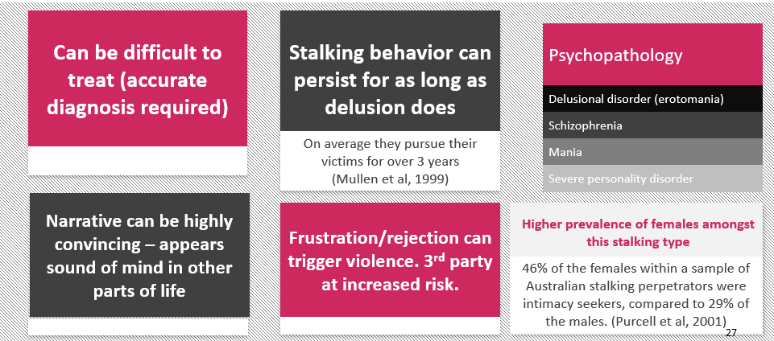
Clinical factors & risks

Slide 47
Most prevalent mental health diagnoses according to typology (616 MASP referrals 2018-2022)
Rejected
Personality issues
Resentful
Personality issues
Incompetent suitor style
Personality issues
Anxiety disorders
Learning disability
Intimacy seeking
Predatory
Psychosis
Personality issues
Depression
Psychosis
ASD
Notes:
This summarises the most prevalent diagnoses according to typology.

Slide 48
Intimacy seeking stalking: Implications for policing
Upon arrest
Be aware that they may have severe mental illness and contact HLDS
If appear very unwell, consider removal to place of safety
If appear to have delusions of harming victim or hear voices to do so – red flag risk item, consider removal to place of safety
Upon interview
Presence of a severe mental illness does not mean case can’t be prosecuted but may mean will need to liaise with their Responsible Clinician (Psychiatrist) about their mental capacity to be interviewed.
Safeguarding
Increased risk to 3rd parties (e.g. victim’s partner) – ask them about their feelings towards those they may see as getting in the way of a relationship with the victim, safeguard as required

Slide 49
Intimacy seeking stalking: Implications for management
Refer to mental health team
Working closely with their care coordinator/mental health team is essential
If appear to have delusions of harming victim or hear voices to do so – red flag risk item, develop risk management plan

Slide 50
Implications for mental health treatment We need to tailor treatment according to MH issues within each typology + individual formulation
Rejected
Resentful
Incompetent suitor style
Intimacy seeking
Predatory
Amelioration of problematic personality issues, attachment issues, depression and anxiety disorders (the feeling of being unsafe in an unsafe world when outside of a relationship)
Amelioration of problematic personality issues, anxiety and depression
Treatment needs to encompass social skills and accommodate issues connected with autism learning needs, as well as consider problematic personality issues
Higher incidence of psychosis suggests these cases need to be referred for psychiatric assessment early in the criminal justice process (important as stalking often persists for as long as delusion does so early treatment reduces risk)
Treatment aimed at amelioration of problematic personality issues
May be longer term due to severity of difficulties
Notes:
This would include …..

Slide 51
Intimacy seeking stalking case example: Claire’s journey into MASP
Complaints to police of Claire stalking male coffee shop vendor
Police force stalking coordinator reviewed case and bought to weekly RAP panel for multi-agency discussion.
HIOW NHS team provided psychiatric input
What is non-intimate stalking? Dr Kirsty Butcher, MASP, HIOW NHS Trust, 12.02.2025

Slide 52
Intimacy seeking stalking case example: Claire’s engagement with HIOW NHS team
Background
Middle aged female with three children
No past psychiatric history
Became infatuated with vendor at local coffee shop and stalked him for a month: loitered at the coffee shop, proclaimed her love, told his colleagues that he is the father of her children.
Breached a RO several times.
Sectioned in hospital but absconded on numerous occasions, only to be found at the coffee shop waiting for her victim.
Psychosis was queried but a tribunal discharged her.
What is non-intimate stalking? Dr Kirsty Butcher, MASP, HIOW NHS Trust, 12.02.2025

Slide 53
Intimacy seeking stalking case example: Claire’s engagement with HIOW NHS team
Intervention and outcomes
Our Consultant Forensic Psychiatrist assessed Claire and diagnosed her with delusional disorder.
Provided advice to her mental health team regarding appropriate medication.
The stalking stopped.
However, some months later, (following the end of supervision under probation) Claire stopped her medication and started stalking again.
Jim again advised her mental health team about the importance of medication adherence; Claire recommenced her medication.
The stalking stopped.
However, Claire has since stopped her medication again and is remanded in custody due to a re-emergence of the stalking.
Jim is liaising with her mental health team about mental health disposals which may mandate her medication use.
This case highlights the need for both treatment and external controls
What is non-intimate stalking? Dr Kirsty Butcher, MASP, HIOW NHS Trust, 12.02.2025

Slide 54
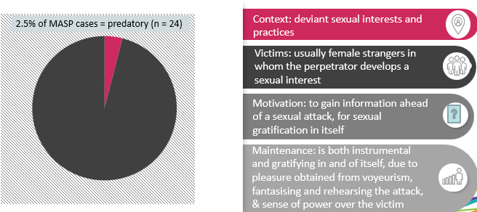
Non-intimate stalking
4. Predatory stalking

Slide 55
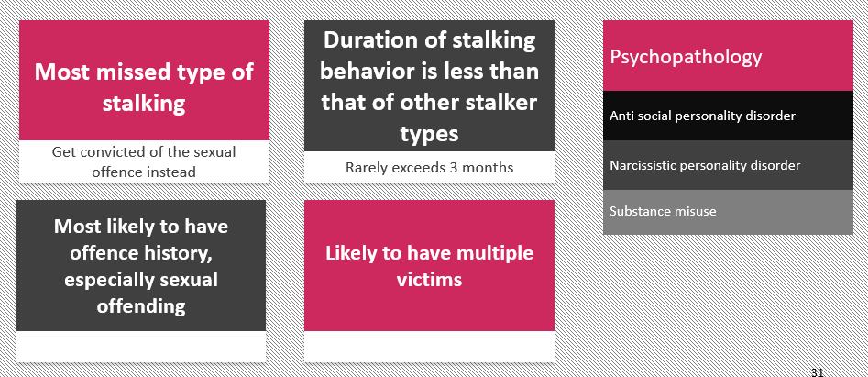
Clinical factors & risk
Notes:
Mullen et al 2009 p.111

Slide 56
Predatory stalking: Implications for policing/management
Associated offences
Be aware of the serial nature of this offence, may have also committed other sexual offences and stalked other victims
Don’t drop the stalking charge! Charge for this alongside other offences as this has implications for treatment & management
Recognise that stalking may be an element of the sexual offence for which you are managing them
Engagement
May have issues with substance misuse
May have a paranoid thinking style, problems controlling emotions, sense of superiority
May feel threatened and so respond with aggression, attempting to control the interview/supervision session, or attempting to appear intellectually superior/denigrating of interviewing officers/probation officer
Safeguarding
Highly recidivistic

Slide 57
Most prevalent mental health diagnoses according to typology (616 MASP referrals 2018-2022)
Rejected
Personality issues
Resentful
Personality issues
Incompetent suitor
Personality issues
Anxiety disorders
Learning disability
Intimacy seeker
Predatory
Psychosis
Personality issues
Depression
Psychosis
ASD
Notes:
This summarises the most prevalent diagnoses according to typology.

Slide 58
Implications for mental health treatment We need to tailor treatment according to MH issues within each typology + individual formulation
Rejected
Resentful
Incompetent suitor style
Intimacy seeking
Predatory
Amelioration of problematic personality issues, attachment issues, depression and anxiety disorders (the feeling of being unsafe in an unsafe world when outside of a relationship)
Amelioration of problematic personality issues, anxiety and depression
Treatment needs to encompass social skills and accommodate issues connected with autism learning needs, as well as consider problematic personality issues
Higher incidence of psychosis suggests these cases need to be referred for psychiatric assessment early in the criminal justice process (important as stalking often persists for as long as delusion does so treatment reduces risk)
Treatment aimed at amelioration of problematic personality issues
May be longer term due to severity of difficulties
Notes:
This would include …..

Slide 59
Predatory stalking case example: William’s journey into MASP
Referral directly into MASP from NPS Probation Practitioner
Discussed in weekly RAP panel & information shared.
Taken on by HIOW NHS team for PLSI intensive
What is non-intimate stalking? Dr Kirsty Butcher, MASP, HIOW NHS Trust, 12.02.2025

Slide 60
Predatory stalking case example: William’s engagement with HIOW NHS team
Background
Young married man with successful career
No psychiatric history or mental health difficulties
For the previous four years had been following women and recording them covertly on his phone.
Some women he would follow only once, during the current offence, he followed the victim for several months, initially from afar and then increasing his proximity to her
This led to his arrest and conviction for stalking 4a
Previous conviction for sexual assault.
What is non-intimate stalking? Dr Kirsty Butcher, MASP, HIOW NHS Trust, 12.02.2025

Slide 61
Predatory stalking case example: William’s engagement with HIOW NHS team
Intervention and outcomes
Initial consultation and risk assessment with Probation Practitioner, risk of continuing stalking = high, some psychological distress
Engaged in 13 sessions, during which he:
Identified the impact of his childhood experiences upon his stalking behaviour and current functioning
Developed an understanding of why he engaged in the stalking behaviour, and how he can avoid it in the future (exits from the cycle of offending)
Learnt skills to enable him to make changes in his life
Outcome measures indicated his risk decreased from high moderate & his psychological wellbeing & functioning improved
What is non-intimate stalking? Dr Kirsty Butcher, MASP, HIOW NHS Trust, 12.02.2025

Slide 62
Conclusion: Non-intimate stalking accounts for almost a quarter of stalking cases in Hampshire & IOW
Non-intimate
23%
Incompetent suitor style 7%
Resentful 6%
Unknown 4.5%
Intimacy seeking 3%
Predatory 2.5%
Ex-intimate (rejected)
76%
Typologies of referrals to MASP 04.2023 - 02.2025

Slide 63
Conclusion: which highlights the complexity of stalking
Therefore, the work of MASP is vital in:
Promoting an understanding of stalking which enhances the care and management of people who engage in stalking through integrated working and improved risk management decisions
Providing mental health intervention alongside robust criminal sanctions to address the behaviour at the top of the iceberg, and the underlying issues lurking below.

Slide 64
Thank you for your time
Presentation citation:
Dr K. Butcher “What is non-intimate stalking? Examining typologies other than rejected”. Stalking Deep Dive Conference, Winchester, 12th February 2025.
Contact:
Kirsty.butcher@southernhealth.nhs.uk
What is non-intimate stalking? Dr Kirsty Butcher, MASP, HIOW NHS Trust, 12.02.2025

Slide 65
References
Home Office. Stalking and Harassment Dashboard.8th March 2023. Downloaded on 13.7.23 from https://vawg.gss-data.org.uk/dashboards/stalking-and-harassment
McEwan, T. E., & Strand, S. (2013). The role of psychopathology in stalking by adult strangers and acquaintances. Australian & New Zealand Journal of Psychiatry, 47(6),546–555.
Mohandie, K., Meloy, J., Green-McGowan, M., & Williams, J. (2006). The RECON typology of stalking: Reliability and validity based upon a large sample of North American stalkers. Journal of Forensic Sciences, 51(1), 147–155.
Mullen, P., Pathe, M. and Purcell, R. (2009) Stalkers and their Victims. Cambridge: Cambridge University Press
Mullen, P., Pathe, M. and Purcell, R., & Stuart, G. (1999). A study of stalkers. American Journal of Psychiatry, 156, 1244-9.
Purcell, R., Pathe, M., & Mullen, P.E. (2001). A study of women who stalk. American Journal of Psychiatry, 36, 114-20.
Senkans, S., McEwan, T. & Ogloff, J. (2017). Assessing the Link Between Intimate Partner Violence and Post relationship Stalking: A Gender-Inclusive Study. Journal of Interpersonal Violence, ﻿1–31
Stark, E. (2009) Coercive Control. How men entrap women in personal life. Oxford: Oxford University Press
What is non-intimate stalking? Dr Kirsty Butcher, MASP, HIOW NHS Trust, 12.02.2025

Slide 66
hiowhealthcare.nhs.uk

Slide 67
Lived Experience

Slide 69
Psychological routes towards and away from stalking behaviour: An autistic individual's reflections
Workshop Presentation
Hampshire Multi-Agency Stalking Partnership Conference
February 12th 2025
Daniel Lodge BSc (Hons), MSc (Dist), GMBPsS

Slide 70
Today's aims...
This workshop explores psychological routes towards and away from stalking of autistic individuals by interweaving expertise by experience informed by academic, professional and personal reflections.
This workshop aims to encourage ideas and the appropriate direction for academia, professionals and practitioners to reflect on in their practice and responsibilities.
This workshop is welcoming discussion of key considerations for improving the inclusivity of autistic individuals via preventative education and support at any life point when stalking behaviours begin to help people desist at the earliest opportunity and learn more healthy ways to navigate the challenging life and inner experiences of autistic individuals

Slide 71
A little about me (contextually)...
Complete dual diagnosis of Autism Spectrum Disorder (DSM-5) and Aspergers Syndrome (ICD-10)
Multiple forensic psychology degrees and published journal articles
Experience with autistic males in prison and community settings
Combines experiential and academic expertise

Slide 72
Thinking about AUTISM SPECTRUM DISORDER (ASD)
A specific type of neurodevelopmental condition is that of autism spectrum disorder (ASD), characterised by persistent deficits in social communication and restricted, often repetitive, patterns of behaviours, interests and activities (American Psychiatric Association, 2013).
Statistics from the United Kingdom (UK) estimate that one in every 100 people is autistic (National Autistic Society, 2023). Recent research has suggested that the number of autistic individuals in the UK could be an estimated 1.2 million people, of which approximately 750,000, aged 20 years or above, are undiagnosed (O’Nions et al., 2023).

Slide 73
Autism and 'social rules'
There are relative differences in rationales provided by individuals with different cognitive styles when comprehending and providing judgements on morally transgressive scenarios, with autistic individuals using fewer abstract rules than non-autistic participants; thus, levels of moral reasoning for individuals with ASD rely more on analytical cognitive skills than experiential live understandings (Shulman et al., 2011).

Slide 74
Thinking about Autistic individuals and you
Have you encountered Autistic individuals in your practice?
What do you take away from those experiences?

Slide 75
Autism and crime
Studies find that autistic individuals are no more likely to engage in offending behaviours than those individuals without a diagnosis but display unique characteristics that warrant further exploration concerning vulnerabilities and motivations for offending (Collins et al., 2022).
Little is known of the prevalence of autism in prison settings. A government review in 2016 found that one-third of prisoners self-identified as having a neurodevelopmental condition (Coates, 2016).

Slide 76
Autism and crime (Cont...)
A small number of unique vulnerability factors attributed to ASD are identified as risks for offending behaviour within the linear context of social exclusion.
Presently, upon contact with the CJS, there is a failure to identify and address autistic people’s cognitive styles and differences through initial and prolonged police contact, questioning and courtroom proceedings with both legal professionals and juries (Slavny‐Cross et al., 2022).

Slide 77
Reflections on Autism and stalking
Rawdon, N., Vinter, L. P., Allely, C., & Wheatley, R. (2024). Exploring the experiences of an autistic male convicted of stalking. The Journal of Forensic Psychiatry & Psychology, 1-34. https://doi.org/10.1080/14789949.2024.2339537
Based on a single case study, Rawdon et al. (2024) proposed factors which may take a person with autism closer towards engaging in stalking:
Hyperfocus;
Obsessions;
Secondary symptoms of depression because of obsessional interests;
A propensity for revenge;
Violent ideation and capacity to engage in violence and a lack of autonomy.

Slide 78
Thinking about Autistic individuals in our work...
Concerning limited evidence to date, is it really the case that there is no link between autism and stalking in your practice/work fields?
Do you have experiences or insights that could offer value to this discussion?

Slide 79
Sharing my experiences...
When I was growing up, there was great difficulty and a lack of support for social skills and friendships.
My first dating experience around the age of 15/16 exhibited stalking-type behaviours upon its ending.
My behaviours exhibited an inability to understand and accept no contact upon the relationship ending.
Frequent phone calls, letters and chance meetings were primary behaviours of mine upon the relationship ending.
I did not encounter the criminal justice system as the developing behaviours were recognised by the parties involved as a mental health issue and reconciled by my caregivers and the caregivers of the female.

Slide 80
My psychological routes towards stalking behaviours....
Undiagnosed autism spectrum disorder is identified as an influential factor that led myself closer to stalking behaviours between the ages of 14 to 16 years of age.
A cognitive style with a preference for systematic thinking led to an inability for me to understand the nuances of socio-sexual relationships.
A hypervigilance was developed towards individuals who may have rejected my displays of traits of autism.
The warmth of a kind person submerged underlying self-esteem issues (partly because of poor reactions to displays of autistic traits in non-autistic-majority settings), psychological discomforts and social difficulties I experienced.
Hyperfocus on a person's warmth led to an unhealthy and problematic hyper-fixation and obsession in the relationship with the person.
Social and interpersonal deficits relating to autism traits led to the eventual end of the relationship and experiences of rejection.
This rejection exacerbated secondary symptoms of depression and developed into a cyclical pattern of attempting to regain and maintain the routines established in the now-ended relationship.
Drivers to reconcile the outcome of the failed relationship were strong and active but unachievable, thus leading to further depressive symptoms and stalking behaviours.

Slide 81
My psychological routes away from stalking behaviours....
Stalking behaviours led to intervention from surrounding adults and resulted in therapeutic support.
Support eventually led to a diagnosis of autism spectrum disorder and Asperger's syndrome.
Holistic autism-informed treatment allowed me to develop cognitive empathy for other individuals.
Cognitive behavioural therapy allowed for support with how to think about and manage socio-sexual relationships.
Confidence was developed through understanding how autism can affect the way I perceived and experienced the world and social relationships.
Social skills were developed, and education on socio-sexual relationships and autism allowed for therapeutic conversations on how to manage future relationships.
Support has been ongoing throughout my life course to maintain and enjoy positive relationships and manage boundaries. Gratefully, this has been a successful approach for me.
My experiences are discussed in far greater detail in a paper currently in peer review titled: Lodge, D. & Wheatley, R. (2025). Psychological routes towards and away from stalking behaviour: An autistic individual's reflections. Forensic Update. Under review.

Slide 82
WHAT CAN WE DO?
Some examples for the Criminal Justice System....
Where stalking-type behaviours are identified, ensuring appropriate assessment tools are used to understand risk, vulnerabilities, support needs and protective and success factors to be developed and harnessed;
Multi-agency and disciplinary input to attend to individual needs to help neurodivergent individuals desist at the earliest opportunity and to address underlying intrapersonal challenges to support their well-being. Additionally, signpost individuals, parents, carers, etc., to autism-specific charities and organisations to maximise support opportunities;
Ensure robust assessments and support measures are facilitated in advocating for and supporting autistic individuals when navigating criminal justice system processes.

Slide 83
Let's discover together...
Email: daniellodge.edu@gmail.com
LinkedIn: Daniel Lodge
Twitter/X: @DanielALodge

Slide 84
Stalking or Harassment?

Slide 85
PURPOSE
Stalking or harassment?
The commitment to end stalking and harassment is embedded in the cross-government Ending Violence against Women and Girls (VAWG) Strategy: 2016 to 2020.
The strategy is underpinned by effective partnership working at both a local and national level.
The successful prosecution of these cases and safeguarding of those victims involved relies on strong and collaborative partnership working between the police and prosecutors
Para 2.1 Protocol on the appropriate handling of stalking or harassment offences between the National Police Chiefs’ Council and the Crown Prosecution Service 2018
Notes:
Stalking and harassment has a serious effect on the victims of crime. It makes victims fear for their safety. It could lead to serious consequences such as murder. In cases of stalking or harassment, the support and safety needs of victims should be identified from the outset, and continually considered throughout the life of a case, by the police in dialogue with the prosecutor. Where available, this should also be informed by any specialist support the victim is receiving, for example, through an Independent Stalking Advocacy Caseworker (ISAC) or an Independent Domestic Abuse Advisor (IDVA). Improving a victim's safety and managing risk through relevant protective orders is important. It may help to increase their confidence in the criminal justice system and facilitate their participation in the investigation and prosecution process. Charging decisions need to be made within the correct time frames. The ramifications for not doing so in cases such as these can be very serious. We need to build strong cases from the outset.

Slide 86
Making decisions as to charges and whether to charge
Legislation
Evidence
The code for Crown Prosecutors
CPS Policies and guidance
Notes:
Under the Director’s Guidance on Charging (6th edition), cases of harassment or stalking cannot be charged by the police; they must be referred to the CPS for a charging decision. There will therefore always be a full review by a charging lawyer.
The CPS will work closely with the police and other agencies to ensure that the best evidence is gathered and presented to the court; there is a Protocol between the CPS and police on the appropriate handling of stalking offences.
What we use to form our decisions
We must prosecute and obtain evidence in accordance with the law, codes, CPS policy and guidance.
Legislation as above.
The Code for Crown Prosecutors is a public document, issued by the Director of Public Prosecutions, that sets out the general principles Crown Prosecutors should follow when they make decisions on cases.
Is there enough evidence against the defendant?
When deciding whether there is enough evidence to charge, Crown Prosecutors must consider whether evidence can be used in court and is reliable and credible, and there is no other material that might affect the sufficiency of evidence. Crown Prosecutors must be satisfied there is enough evidence to provide a "realistic prospect of conviction" against each defendant.
Is it in the public interest for the CPS to bring the case to court?
A prosecution will usually take place unless the prosecutor is sure that the public interest factors tending against prosecution outweigh those tending in favour.

Slide 87
Stalking
Harassment
Controlling or Coercive Behaviour
Notes:
The difficulties the CPS face with charging these offences is because there will often be overlap between offending which is better charged as stalking, and that which is better charged as harassment. There can also often a significant degree of overlap with the Controlling or Coercive Behaviour
Why is it difficult to separate stalking and harassment?
• There are similarities in what constitutes harassment and what is stalking.
• They are often discussed together and don’t separate.
• There is an overlap, and some people may be a victim of both.
• A lot of the abuse techniques are the same, but become stalking when used more aggressively, more threateningly and more obsessively.
• There is overlap two legal definitions overlap.
If we go back to where it all started the briefing paper for the 1997 it says this - The Protection from Harassment Act 1997 was originally introduced to deal with the problem of stalking.
House of commons Briefing paper Number 6648, 9 June 2017

Slide 88
Which charge?
The CPS stalking or harassment guidance provides information on how we make the decision on which is the most appropriate charge.
It is for the prosecutor to consider all the circumstances and facts of the case to arrive at a decision on the appropriate charge, applying the principles set out in the Code for Crown Prosecutors
Notes:
When considering what charges (if any) are applicable, prosecutors will examine the impact on the complainant as well as the conduct of the suspect to determine whether someone has been stalked or harassed.
The CPS Legal Guidance on Stalking or Harassment states that where the course of conduct involves significant elements of stalking behaviour, a charge under s.2A or s.4A should be the starting point.
The starting point be should be to ask what reasons there are for not charging stalking, instead of using harassment as the starting point.
Prosecutors should therefore consider potential charges in the following order:
If there is sufficient evidence for the elements of stalking involving fear of violence or serious distress or substantial adverse effect on the victim’s usual day-to-day activities , the offence contrary to section 4A Protection from Harassment Act 1997 may be the best offence to charge in order to reflect the seriousness and extent of the offending, give the court adequate powers to sentence and enable the case to be presented in a clear and simple way. The non-exhaustive list in section 2A (3) Protection from Harassment Act 1997 provides examples which can constitute stalking. These may overlap with CCB or harassment. However, behaviours which show a fixation, are obsessive, unwanted, and repeated might most clearly be presented to a court as stalking rather than harassment or CCB. This is relevant to the way the case is presented, note also in respect of sentencing powers that the maximum penalty is 10 years’ imprisonment, and a Stalking Protection Order is available as a civil order to protect victims.
If there is insufficient evidence to charge stalking, but there is sufficient evidence to charge section 4 Protection from Harassment Act 1997, the section 4 charge may be the most appropriate. Section 4 harassment is only available where fear of violence is caused, not serious distress which is available for section 4A stalking. Section 4 harassment may overlap with CCB, for example, threats to hurt or harm the victim or their family members and threats of sexual assault. Section 4 may be the more appropriate offence in respect of the sentencing powers available to the court, because the maximum penalty is 10 years’ imprisonment.
If there is insufficient evidence to prosecute section 4A and 4 offences, but there is sufficient evidence to charge CCB, then CCB may be the most appropriate offence. This will likely be in cases where the conduct was controlling or coercive, causing serious alarm or distress which affects the usual day-to-day activities of the victim but did not amount to stalking and where no fear of violence was caused. For example, controlling when a person can leave the house, who they can and cannot socialise with, control of their finances and coercing them into debt. The maximum penalty is 5 years’ imprisonment. For that reason, it is likely to be the most appropriate charge in relation to the powers available at sentence, even where section 2A stalking or 2 harassment are also available
Para 4.6 Protocol on the appropriate handling of stalking or harassment offences between the National Police Chiefs’ Council and the Crown Prosecution Service

Slide 89
LAW
Protection from Harassment Act (PHA)1997 Offences
There are 4 relevant offences in the Protection from Harassment Act 1997:
· Section 2 – harassment
· Section 2A – stalking
· Section 4 – harassment involving fear of violence
· Section 4A – stalking involving fear of violence or serious alarm or distress
The ss.2/2A offences are summary only; the ss.4/4A offences are triable either way.
Notes:
section 42A (1) Criminal Justice and Police Act 2001. Section 32 Crime and Disorder Act 1998 creates racially or religiously aggravated versions of the PHA 1997 offences, which have higher maximum sentences than the ‘basic’ PHA offences. Where a PHA offence involves hostility based upon sexual orientation, transgender identity or disability, then the sentence uplift provisions of section 66 Sentencing Act 2020 will apply.

Slide 90
S2 Harassment
Charge-
That you on (Date) at (Place) pursued a course of conduct which amounted to the harassment of X and which you knew or ought to have known amounted to harassment of him/her/them in that you (details, dates, place, and nature of conduct)
Contrary to s.2(1) and (2) Protection from Harassment Act 1997.
ELEMENTS of the offence:
The defendant must have:
· Pursued a course of conduct
· The course of conduct amounts to harassment of another
· The defendant knows or ought to have known that the conduct amounts to harassment of the other.
Maximum penalty – unlimited fine (adult offender; formerly level 5 fine) and/or six months’ imprisonment.
Notes:
Harassment is partially defined in s.7(2) PHA as including “alarming the person or causing the person distress”.
However, the case of R v O’Neill (also known as R v ZN) [2016] EWCA Crim 92 clarified that ‘harassment’ could not simply be equated with alarm or distress. The court stated that ‘harassment’ should be understood to involve “improper, oppressive and unreasonable conduct that is targeted at an individual and calculated to produce the consequences described in s.7.”

Slide 91
S7 (2) PHA 1997
7 Interpretation of this group of sections.
(1)This section applies for the interpretation of sections [F1sections 1 to 5A].
(2)References to harassing a person include alarming the person or causing the person distress.
[F2(3)A “course of conduct” must involve—
(a)in the case of conduct in relation to a single person (see section 1(1)), conduct on at least two occasions in relation to that person, or
(b)in the case of conduct in relation to two or more persons (see section 1(1A)), conduct on at least one occasion in relation to each of those persons.

Slide 92
Harassment – I OUT C
Improper
Oppressive
Unreasonable conduct
Targeted at an individual
Calculated to produce the consequences described in s.7 (alarming the person or causing the person distress)
KEY:
BEHAVIOUR
IMPACT
Notes:
R v ZN [2016] EWCA Crim 92
The definition provided by s.7 is clearly inclusive and not
exhaustive… ‘Harassment’ is generally understood to involve
improper oppressive and unreasonable conduct that is
targeted at an individual and calculated to produce the
consequences described in s.7. By s.1(3) of the Act…
reasonable and/or lawful courses of conduct may be excluded.
The practice of stalking is arguably the prime example of
harassment….but a wide range of other actions could, if
persisted in, be so categorised. A course of conduct which is
unattractive and unreasonable does not of itself necessarily
constitute harassment; it must be unacceptable and
oppressive conduct such that it should sustain criminal
liability…… Harassment includes negative emotion by repeated
molestation, annoyance or worry. The words ‘alarm and
distress’ are to be taken disjunctively and not conjunctively,
but there is a minimum level of alarm or distress which must
be suffered in order to constitute harassment. ”

Slide 93
2A Stalking
Charge
That you on (Date) at (Place) pursued a course of conduct which amounted to the stalking of X and which you knew or ought to have known amounted to harassment of him/her/them in that you (details, dates, place, and nature of conduct)
Contrary to s.2A(1) and (4) Protection from Harassment Act 1997.
ELEMENTS of the offence:
The defendant must have:
· Pursued a course of conduct in breach of s.1(1)
· The course of conduct amounted to stalking
· The defendant knows or ought to have known that the conduct amounts to harassment of the other.
It is therefore an offence of s.2 harassment, with the additional element that the course of conduct amounts to stalking.
Maximum penalty – unlimited fine (adult offender; formerly level 5 fine) and/or six months’ imprisonment.
Notes:
Examples of acts or omissions which, in particular circumstances, are ones associated with stalking are given in s.2(3):
· Following a person
· Contacting, or attempting to contact, a person by any means
· Publishing any statement or other material relating or purporting to relate to a person / purporting to originate from a person
· Monitoring the use by a person of the internet, email or any other form of electronic communication
· Loitering in any place (whether public or private)
· Interfering with any property in the possession of a person
· Watching or spying on a person.
This is not an exhaustive list.

Slide 94
Stalking - FOUR
Fixated
Obsessive
Unwanted
Repeated
KEY
BEHAVIOUR
IMPACT
Notes:
Examples of acts or omissions which, in particular circumstances, are ones associated with stalking are given in s.2(3):
· Following a person
· Contacting, or attempting to contact, a person by any means
· Publishing any statement or other material relating or purporting to relate to a person / purporting to originate from a person
· Monitoring the use by a person of the internet, email or any other form of electronic communication
· Loitering in any place (whether public or private)
· Interfering with any property in the possession of a person
· Watching or spying on a person.
This is not an exhaustive

Slide 95
S4 Harassment involving fear of violence
Section 4 Harassment offence
Charge
That you on (Date) at (Place) caused X to fear that violence would be used upon him/her by your course of conduct which you knew or ought to have known would cause fear of violence to X on each occasion in that (details, dates, places, and nature of conduct)
Contrary to s.4(1) & (4) Protection from Harassment Act 1997.
ELEMENTS of the offence:
To prove the section 4 offence, the defendant must have:
· Pursued a course of conduct
· Which causes the other to fear on at least two occasions that violence will be used against him/her
· Which the defendant knows or ought to know that the victim will fear that violence will be used against him or her (“Will” means a greater degree of certainty than “might” or “could”).
PENALTY
Summary disposal, unlimited fine (adult offender; formerly level 5) and/or 6 or 12 months’ imprisonment (see “General limit in a magistrates’ court” in Chapter 5).
At Crown Court: ten years’ imprisonment and/or unlimited fine

Slide 96
Section 4A – stalking involving fear of violence or serious alarm or distress
Section 4A Stalking offences
Charges
There are two separate ways to commit s.4A; do not include both in one charge.
Fear of violence:
On (Date) at (Place) your conduct amounted to stalking and caused X to fear, on at least two occasions, that violence would be used against him/her when you knew or ought to have known that your course of conduct would cause fear of violence to X on each occasion in that (details, dates, places and nature of conduct)
Contrary to s.4A(1)(a)(b)(i) & (5) Protection from Harassment Act 1997.
Or
Serious alarm or distress:
On (Date) at (Place) your conduct amounted to stalking and caused X serious alarm or distress, which had an adverse effect on his/her usual day-to-day activities when you knew or ought to have known that your course of conduct would cause alarm or distress to X on each occasion in that (details, dates, places and nature of conduct)
Contrary to s.4A(1)(a)(b)(ii) & (5) Protection from Harassment Act 1997.
PENALTY
Maximum penalty: Summary disposal, unlimited fine (adult offender; formerly level 5) and/or 6 or 12 months’ imprisonment (see “General limit in a magistrates’ court” in Chapter 5).
At Crown Court: ten years’ imprisonment and/or unlimited fine.

Slide 97
Section 4A – stalking involving fear of violence
ELEMENTS of the offence:
To prove the ‘fear of violence’ section 4A offence, the Defendant must have:
· Pursued a course of conduct
· Which amounted to stalking (see s.2A above)
· Which causes the other to fear on at least two occasions that violence will be used against him/her.
· Which the defendant knows or ought to know that the victim will fear that violence will be used against him or her on each occasion (“will” means a greater degree of certainty than “might” or “could”)

Slide 98
Section 4A – stalking involving serious alarm or distress
ELEMENTS of the offence:
To prove the ‘serious alarm or distress’ section 4A offence, the Defendant must have:
· Pursued a course of conduct
· Which amounted to stalking (see s.2A above)
· And caused serious alarm or distress
· Which had a substantial adverse effect on the victim’s day-to-day activities
· Which the defendant knows or ought to know would cause such alarm / distress on each occasion (“will” means a greater degree of certainty than “might” or “could”).

Slide 99
BUILDING ROBUST AND EFFECTIVE CASES
The bigger picture
Witness statements
Interrogatiing all systems
Evidence from all sources
Defence

Slide 100
SCOTT SCHEDULES
 | Date | Allegation | Exhibit reference | Defendant response | Court finding
1.
2.
3.
4.
5.
6.
7.
Notes:
A scott schedule is a table. They are used in family court proceedings to clearly set out the allegations that are in dispute.
Why can they help with stalking or harassment cases?
I have prosecuted several cases of stalking and harassment in the Magistrates Court. One particular Judge, DJ Robinson, suggested using a scott schedule for these cases. Why? The cases are by their nature often lengthy and complex. To navigate these can take a considerable amount of time. At trial Victims can become confused and find it difficult to recall incidents that may have occurred over several months. Having a clear table of the alleged behaviour, references to the exhibits that demonstrate that behaviour. Further the defendant has to provide a response as to whether the accept the behaviour or not and the reason for it. This can help with RLOE and narrowing down the issues in case – think PET and BCM what are the real issues in the case. But moving this back to the very beginning it can provide a clear understanding of what has happened and what evidence supports this. It can also lead to effective and efficient charging decisions. It may assist with getting early guilty pleas.

Slide 101
15. | 29.9.21 17:41 | Email from A.B@yahoo.com “I can’t take this anymore not being able to fix this when you no how I feel about you but all you want to do is listen to other people lies about me when you no they ain’t true and to be honest I really don’t care about the police being involved or my bail because I really do care about you and will go above and beyond to fix this and make everything up to you all I ask is you do the right thing and I no you still care” Effect of messages on Victim – statement 1/10 Statement 1/10 Email sent from email address D had given police in 2017 | DE/EMAIL/01
16. | 3.10.21 | PUBLIC HOUSE Attended D E’s workplace Victims Statement bundle No. 5/10
18. | 10.10.21 13:44 | SUNDAY EMAIL Email from A.B@yahoo.com ”hey this has killed me there is not a day that goes by I don`t think about I just want this to end and wanted to tell you I`m struggling with out you” Victims Statement 10/10 Email address – one police had for D from 2017 Had bail conditions not to contact her | DE/EMAIL/01

Slide 102
The future
In November 2024, the CPS and NPCC published the Domestic Abuse Joint Justice Plan (DA JJP) which promotes early communication between investigators and prosecutors and prioritises improving the recognition and identification of behaviour driven offending. The DA JJP applies to domestic and non-domestic stalking, and it is captured within the plan as high-harm, high-risk repeat offending.
Notes:
The DA JJP notes - The best performing Forces and CPS Areas for victims of domestic abuse are the ones which have the closest professional relationships, and work collaboratively to achieve improvements and problem solve together.
So taking it back to my very first slide -The successful prosecution of these cases and safeguarding of those victims involved relies on strong and collaborative partnership working between the police and prosecutors.

Slide 103
Useful links
Stalking-and-Harassment-Protocol-2018_1.docx
https://www.cps.gov.uk/legal-guidance/stalking-or-harassment
https//www.cps.gov.uk/publication/code-crown-prosecutors
Protection from Harassment Act 1997
https://www.justice.gov.uk/courts/courts/procedure-rules/civil/standard-directions/general/scott

Slide 105
Cyber Stalking
Paul Masters
Digital Change Programme
(Hampshire & Isle of Wight Constabulary)

Slide 106
Lived Experience

Slide 108
Dr Rachel Worthington Understanding Adolescent Stalking through a Developmental Lens – Trends and Updates

Slide 109
Aims
What is adolescence?
How might this bias our thinking?
What is stalking?
Future Research
Interventions
Implications for practice

Slide 110
Thinking back to when you were a teenager....

Slide 111
What was your favourite outfit to wear?

Slide 112
Favourite music to listen to?

Slide 113
What did you do that you would never tell your parents? Or teachers?

Slide 114
As a teenager How many of you have…
“Tried to ‘talk’ with someone when it seemed like they did not want you to.

Slide 115
Would you do that now?

Slide 116
Let’s have a think about why….

Slide 117
What is adolescence?
Phase of life between childhood and adulthood (WHO, 2022).
The UN Convention on the rights of a child and the WHO define adolescence as ranging from 10-19 but others suggest this should be end between the ages of 18-26 (Patton et al. 2016).
Cultural variations - social construct (stages between childhood and adulthood) as well as a biological construct (e.g. puberty).

Slide 118
What springs to mind when we think of teenagers?

Slide 119
Common things said to teenagers…
Why don’t you just think about other people for a change?
Stop being so selfish..
What don’t you just think about what you’re doing?
What did you do that for?
Calm down!

Slide 120
Adolescence and Biology
Hormones
Frontal Cortex
‘Consequential thinking and impulsivity
Reduced decision making
Increased risk taking
Reduced emotional regulation

Slide 121
And not only that....
Increased capacity for social interactions

Slide 122
AND
Increased independence...

Slide 123
Brain Plasticity
The plasticity of the developing adolescent brain means:
It is shaped more by life experiences than adults (Giedd 2003)
It is shaped more by exposure to social environments within specific cultures (Blakemore and Mills 2014).
This happens not just in terms of synaptic pruning in the brain, but also through the shifting cognitive and emotional neural systems maturing at a different pace (Choudhury et al. 2008).

Slide 124
The pleasure-seeking reward system of the adolescent brain develops faster than the part of the brain which is responsible for planning ahead and judgement. This in turn makes them more prone to engage in risky impulsive behaviours (Chein et al. 2011

Slide 125
Adolescents are...
Seeking more social connections
Seeking more independence
Are more emotional
With reduced consequential thinking, logic and emotional regulation

Slide 126
Why does age matter?
Basic abilities, such as those involving memory, attention, and logical reasoning, can develop by the age of 15 however skills such as thinking ahead and balancing risks and rewards are not developed until the mid-20s (Giedd 2008).

Slide 127
So when should we think of someone as an adult?

Slide 128
A reminder
WHO – age 10-19
Others suggest this should be end between the ages of 18-26 (Patton et al. 2016).

Slide 129
Assessments of adolescent stalking
Stalking Risk Profile (SRP) is validated on people aged 18 and over.
Designed on the five typologies of stalking in adults and the risk factors associated with these typologies (McEwan et al. 2018).

Slide 130
Rate an adolescent...

Slide 131
In summary...
“although one may define puberty in specific neuroendocrinological terms,… adolescence is, of its essence, a period of transition rather than a moment of attainment, and so, it is difficult to distinguish its beginning or end” (Spear 2000 p. 417).

Slide 132
So how does this apply to stalking?
Definitions of stalking vary across the world
In the adult literature, stalking has been defined as a course of conduct consisting of unwanted attention directed by one individual toward another that induces fear in the victim (Mullen et al. 2000).
‘five plus two’ (five unwanted intrusions over two weeks) (McEwan et al. 2020) but with the caveat that the behaviour should also cause fear or distress to the victim.

Slide 133
‘Prevalence’ of adolescent stalking
Purcell et al (2009) found that 57% of adolescents in their sample engaged in stalking behaviour towards someone of the same gender with this being most common in females [86.1% females compared to 40.3% in males]. This was noted to be friends and not just ex-intimate partners
Pereira et al. (2016) found that 66.1% of victims of cyber-harassment and stalking were also perpetrators.
Adolescents predominantly engage in stalking behaviours towards other adolescents (Roberts et al. 2016; Purcell et al. 2009; Haugaard and Seri 2004).
Fisher et al. (2014) found that 27% of adolescents who reported being attracted to someone of the same sex reported being victims of stalking in comparison to 15% of students who reported being attracted to the opposite sex

Slide 134
Stalking =
Five instances
Two (weeks)
Fear

Slide 135
Let’s start with Fear..
In the US this is acknowledged through the ‘reasonable person standard (National Center for Victims of Crime 2007, p.48) which states that behaviour can constitute stalking if a reasonable person would have experienced emotional distress from it.
However, in the UK without evidence of fear or distress the same behaviour only amounts to harassment and not stalking

Slide 136
Adolescent intent to cause fear?
Empathy is the ability to understand the emotional states of others
It has an impact on how people act in social situations (Overgaauw et al. 2017).
Empathy changes in adolescence:
It increases in females (gender identification hypothesis)
But decreases in males (testosterone levels, Hermans et al, 2006)

Slide 137
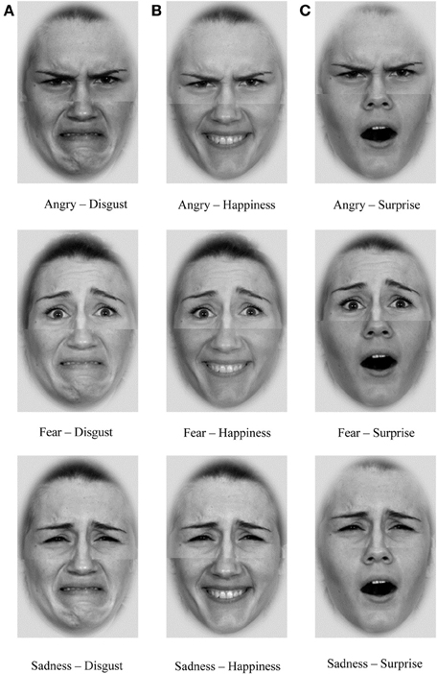
When shown faces only 50% of the adolescents could identify fearful expressions in comparison to 100% of adults

Slide 138
Adolescence and Empathy..
Research has shown that the more complex social processes, such as understanding the mental states of others (Blakemore et al. 2007), social emotional processing (Burnett et al. 2009) and negotiating complex interpersonal decisions (Crone 2013), continue to develop throughout adolescence (Apperly 2010; Blakemore 2012).
Adolescents differ in their capacity to read and understand the emotions in the faces of others (Yurgelun-Todd and Killgore 2006).
Adolescents (aged 11-17) in comparison to adults, the adolescents had less activity in the amygdala (which is responsible for identifying fear and other emotions) and frontal lobes.

Slide 139
Adolescence and feeling afraid...
Fear is a poor marker of what constitutes legitimate stalking and the risk of violence in young people (Smith-Darden et al. 2016)
Regardless of whether the victim reports feeling fearful, they are still at risk of violent victimisation.
Spitzberg (2016) found that 18% of adolescents who reported being victims of stalking behaviour stated they were not fearful of this and females were more likely to under-acknowledge stalking behaviour (not label this as stalking even though it met the threshold).
Smith-Darden et al. (2016) found that adolescents who engaged in stalking are violent in their behaviour and that the rate of reported fear of the victim is “irrelevant” (p198) because regardless of the victim’s perception of harm, adolescents pose a risk of violent stalking people misjudge/under-estimate the threat towards them

Slide 140
Why?
The illusion of infallibility
Results in a decreased perceived risk of harm to the self and increased involvement in risk behaviours (Casey et al. 2008; Leone et al. 2005; Monneuse et al. 2008).
PLUS if not fearful does not meet the threshold under UK law for stalking

Slide 141
Playing down fear …“don’t grass.. we all do it”..
Pereira et al. (2016) found that 66.1% of victims of cyber-harassment and stalking were also perpetrators.
Thus, it is possible that adolescent stalking is normalised as a behaviour young people are likely to be exposed to and as a result of the frequency of this young people may not report fear as a legitimate response.
Research shows that young people are also reluctant to report offences due to the risk of reputational damage and unwritten group ‘rules’ in certain social contexts which result in a silencing power over young people’s likelihood of reporting crime (Beckett and Warrington 2014).

Slide 142
Adolescence intent to cause harm?
‘Stalking’ as protection from harm?
Adolescent females described how before dating a partner they used friends to ‘stalk’ the person and that they would “do their homework” (p781) on potential partners and monitor them to see if there were any signs they would be unfaithful.
Narrative of ‘stalking’ but does not meet the criteria?
Mislabelling behaviour

Slide 143
Adolescence and Fear
Only 5.7% of adolescents report the ‘five plus two’ intrusions to cause them fear or distress in comparison to 30% in adults (McEwan et al. 2020).

Slide 144
Stalking =
Five instances
Two (weeks)
Fear

Slide 145
Let’s think about the 5 plus 2 for adolescents...

Slide 146
Tactics used in adolescent stalking..
Ex partner:
Fisher et al (2014) 89% of stalking victims reported they received unwanted communication via media in comparison to 50% who reported the person ‘showed up at places when not wanted’

Slide 147
Adolescence and social media use
90% of adolescents aged 13-17 have used social media with 51% reporting they use it at least daily with an average of nine hours per day spent online (excluding time for homework).
Teen users of SnapChat check the app an average of 30 times daily (Piper Sandler Companies 2021) with use of snapchat/instagram alone accounting for nearly an hour and a half a day. This is in comparison to an average 30 minutes per day in adults (Shepherd 2022).
One in three adolescents send more than 100 text messages a day or more than 3000 text messages per month (Pew Research Centre 2010) with females aged 14-17 being the most active.
This is in comparison to adults who send 13 texts on their personal cell phones every day (Zipwhip 2021).

Slide 148
Frequency of adolescent communication
Adolescents communicate with each other via social media differently to adults whereby adolescents may not wait for a reply before sending another message (Ehrenreich et al. 2020)
On average send 400 messages to peers and another 435 messages to romantic partners in a four day period.
They may send multiple messages before receiving a reply.
They respond faster to peers (14.5 minutes) and romantic partners (9.27 minutes) than they do to their parents (50.39 minutes) (Ehrenreich et al. 2020).

Slide 149
Legitimacy of contact
Stalking involves ‘imposing oneself on another person in a context where the perpetrator has no legitimate right’ (Purcell et al, 2009)

Slide 150
Legitimacy of contact
50% of adolescent stalking victims reported the perpetrator tactics included ‘showing up at places’. However, as noted by Purcell et al. (2009) the majority of stalking behaviour in their sample commenced in the school setting and were perpetrated towards school peers.
Limited social mobility of adolescents should be considered when exploring the tactics used such as coming into close proximity to the victim because if the victim and perpetrator go to the same school/college then such contact could be deemed legitimate.
This may explain the increased likelihood of stalking acquaintances compared to former partners (Roberts et al. 2016)

Slide 151
School as a place of safety?
Students who reported being stalked by their peers or ex-partners who attended the same school experienced depression, suicidal ideation and were ‘sick with fear’ (Purcell et al. 2009).
Cyberstalking literature shows only 4.7% of cyberstalking was undertaken by a former or current romantic partner in comparison to 43.6% who were friends (Pereira et al. 2016).
Adolescents are more likely to engage in risk taking behaviour in the presence of their peers (Silva et al. 2016).
Stalking at school linked with:
unable to concentrate at school
absenteeism
being removed from the school or educated at home

Slide 152
BUT...who is the victim?
Rothman et al. (2021) who found one third of their sample of 12-18 year olds who experienced stalking were both victims and perpetrators of stalking behaviour.
Pereira et al. (2016) found that 66.1% of victims of cyber-harassment and stalking were also perpetrators
Adolescent stalking may also mirror the IPV (Intimate Partner Violence) literature in that an individual may be both a perpetrator and victim of adolescent stalking and may engage in both dual perpetration and victimisation.
This is referred to as the victim-perpetrator overlap model (Park and Kim 2019) whereby it is thought that victims of IPV may observe aggression and adopt this behaviour through social learning (Bandura 1971) or they mirror the aggression strategies adopted by perpetrators towards them as a means of coping.
Jang (2013) observed this in victims of school violence and found that the more victimised students became the more violent they became towards others.
Mirrors bullying research in adolescents

Slide 153
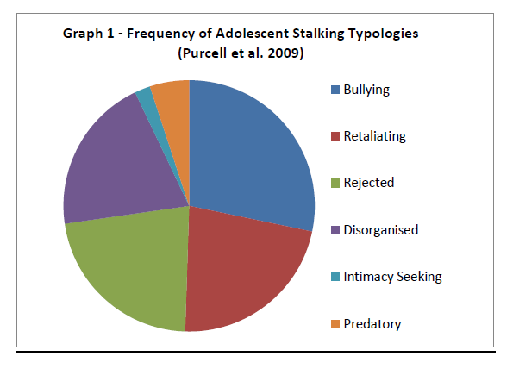
Typologies of Adolescent Stalking?
Notes:
However, the most common typology (28%) was stalking as an extension of bullying whereby the victim was usually a school peer (56%) or an estranged friend (21%). This is particularly interesting given the sample excluded behaviours which happened within the premises of a school. 22% of participants were classed as ‘Retaliating’ stalkers who sought revenge for a perceived wrong against them. No differences were found in gender in the retaliatory group. Only 22% were classified as engaging in stalking towards a former romantic partner (‘Rejected’ Typology) with 86% of these being perpetrated by a male towards a female victim. 20% were classified as a ‘Disorganised’ typology consisting of what was described as angry and delinquent youth who were at ‘war with the environment’ and 47% of these involved harassment of neighbours including threats and property damage. Only 2% of the sample engaged in stalking behaviour motivated by infatuation (intimacy seeking) and 5% were classed as predatory, whereby the function of the behaviour was sexual.

Slide 154
So what do we know? Adolescent Stalking =
Five instances
Two (weeks)
Fear

Slide 155
Problems with the data
Measures of stalking used do not meet 5 plus 2 plus fear
5 plus 2 plus fear may not even apply to adolescents
Research conducted in predominantly individualist cultures may not be generalisable in collectivist countries due to different attitudes towards courtship behaviour (Chan and Sheridan 2017).

Slide 156
What do we do from here?

Slide 157
Research at ManMet
Adolescents aged 16+ can equally recognise stalking behaviour in others compared to adults
But they often do not know where to get help
Adolescents are less fearful and may feel more invincible which reduce reporting behaviour
Their peers may also tell them to ‘ignore it’ even when the behaviour described constituted legal criteria for stalking.
People with a nonsense style of humour are not as good at recognising stalking
Young people also use the term ‘stalking’ loosely to describe someone who is attracted to them when it is not reciprocated
“Stalking” happens at school and online
Female perpetrators are seen as less threatening
ADHD and Autism traits were not associated with stalking
People who engage in cyberstalking may have engaged in cyberbullying BUT cyberbullying does NOT lead to cyberstalking OR in person stalking
Parental Stalking can be an extension of other abuse and victims need support
Teacher-Pupil Stalking means schools may not be a place of safety
Thank you to the following ManMet students for their research contributions:
Stephanie Stajniak
Charlotte Wills
Georgia Pye
Tegan Wellock
Bethany O’Hagan
Amy Wilkinson
Emma Tunnicliffe
Andrei Baciu

Slide 158
Implications for practice
Labelling adolescents as engaging in ‘stalking’ behaviour could pose serious implications in terms of the development of their self-concept and developmental pathway
Adult research and concepts in relation to stalking do not appear to easily generalise onto adolescents both in terms of the demographics of who engages in this behaviour, the prevalence and function.
Given the links between bullying and stalking in adolescents, it is possible that bullying interventions could have some utility in interventions for adolescent stalking.
Clinicians working with adolescents should also be mindful of the potential for adolescents to be both victims and perpetrators of stalking
individuals in a victim-perpetrator dyad may have limited geographical mobility

Slide 159
Implications for assessment
Practitioners working with adolescents should be mindful of the age of their client when reviewing the literature in terms of its applicability to their individual biological and social development
Standardised risk assessment tools for adults may not be valid on adolescents.
Formulations and interventions designed to reduce adolescent stalking vulnerability and risk should take into account the complex multi-systemic factors surrounding stalking behaviour.
Interventions to reduce stalking vulnerability need to be developed based on the literature. These could consider some of the literature in relation to bullying as well as educating students about stalking and the disregard of boundaries in partnerships and the criminal consequences of stalking should be explained (Kliem et al. 2021).

Slide 160
Treatment
‘Dating Matters’ teaches 11-14 year olds healthy relationship skills before they start dating and reducing behaviours that increase the risk for dating violence.
BUT it is unclear how such interventions would target adolescent stalking outside of the context of intimate relationships.
Byers et al. (2019) identified clinical guidelines for working with bullying and cyberbullying which could be applied to adolescent stalking

Slide 161
Implications for research..
Social Media
Victim-Perpetrator Duality
IPV to stalking pathway
Narratives adolescents use to describe stalking
Validated risk assessment tools
Adolescent stalking for clients who identify as LGBTQ+ and/or transgender
Supportive interventions developmentally sensitive

Slide 162
Any questions
r.worthington@mmu.ac.uk

Slide 163
Panel Discussion Q&A

Slide 164
Closing Remarks
Donna Jones
Police & Crime Commissioner for Hampshire & Isle of Wight

